Slide 1
AutoTweetNGFree, PRO, and Joocial
Publishing to Google+ Profiles and Pages
www.extly.com/autotweetng-joocial-publishing-to-gplus-profiles-and-pages.html
Presentation based on Joomla 3 and AutoTweetNG 6.8.0 2013-11-09

Slide 2
Recipe: Improve your social streams
AutoTweetNG allows automatic social publishing from Joomla to Facebook, Google+, LinkedIn, Twitter, and more.
In this presentation, we are going to show how also Google+ can be integrated in a semi-automatic way to your content timeline.
Product Page: http://www.extly.com/autotweet-ng-pro.html
Support: http://support.extly.com Community Forum Support: http://www.extly.com/forum/index.html

Slide 3
Prerequisites
AutoTweetNG Free, PRO, or Joocial v6.8
This tutorial assumes you have already done a basic configuration.
Previous Tutorial:How to AutoTweet from Joomla in 5 minutes

Slide 4
Publishing to Google+ Profiles and Pages
The Google+ API currently provides read-only access to public data.
However… there’s a way to simplify the community manager job.
Google+ API does provide support for “Activities”. An activity is a note that a user posts to their stream. “Moments” describe activities that users engage within an app.
Now, AutoTweetNG supports Google+ Moments.

Slide 5
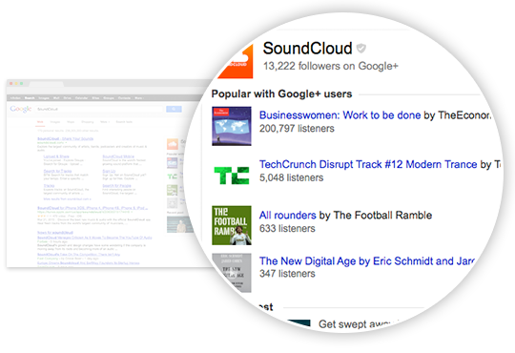
About App Activities
Increase app discovery and drive lasting re-engagement
Build conversations and share activities that matter
Want to increase the discoverability of your app? Aggregated app activities that you send to Google become eligible to appear on the right hand side of Google Search results when users search for your site or app. With a user’s permission, individual app activities can appear on their Google+ profile, visible to people they choose to share with, re-engaging users. These relevant mentions of your app can foster conversations, and create powerful social proof for your service.….
https://developers.google.com/+/features/app-activities

Slide 6
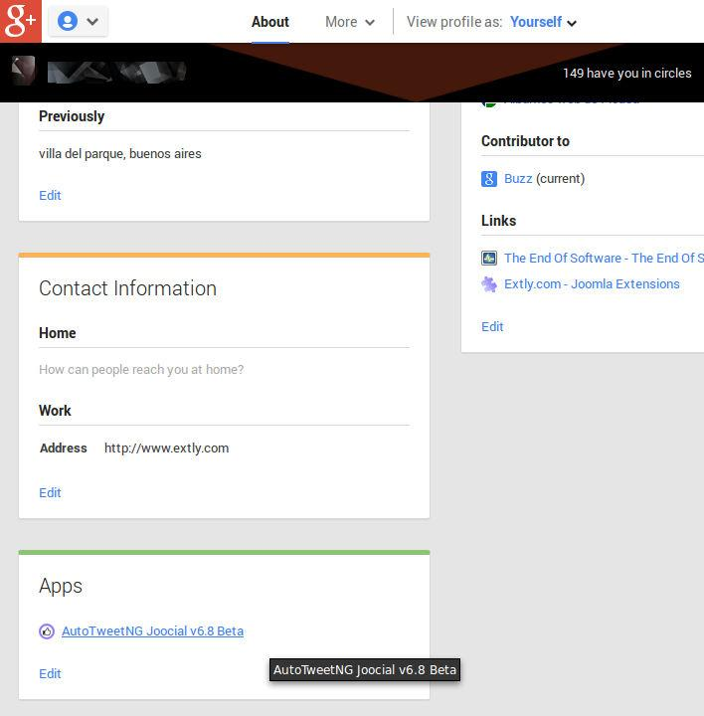
A Google+ Moments channel
How it works:
The community manager creates and authorizes the App publish moments into the user profile.

Slide 7
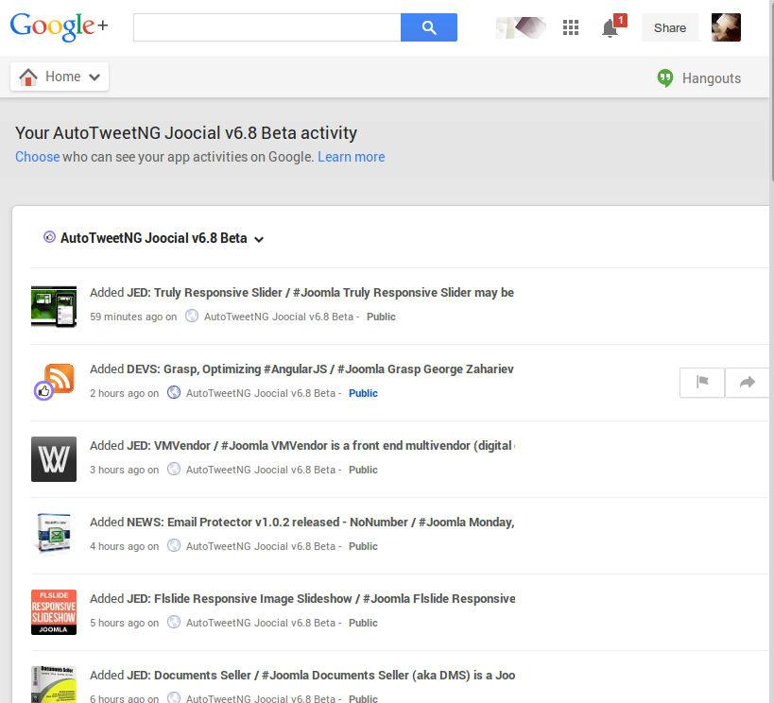
A Google+ Moments channel
How it works:
Moments are registered in profile
Moments are public
Moments can be shared

Slide 8
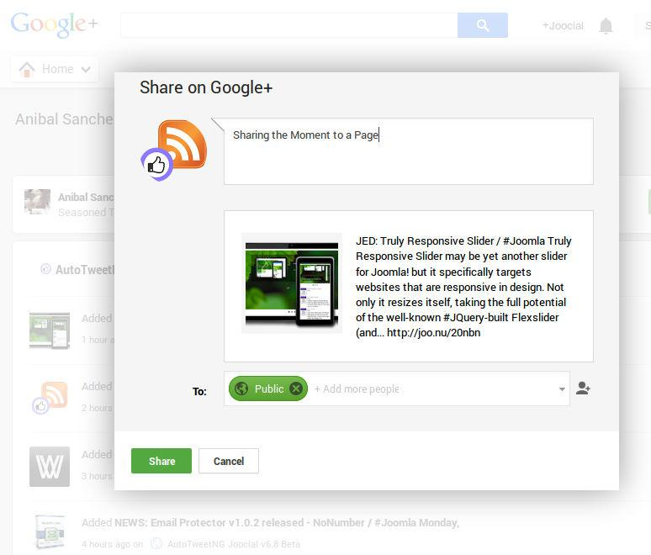
A Google+ Moments channel
How it works:
Moments can be shared to a Profile or a Page
They can only be shared manually.

Slide 9
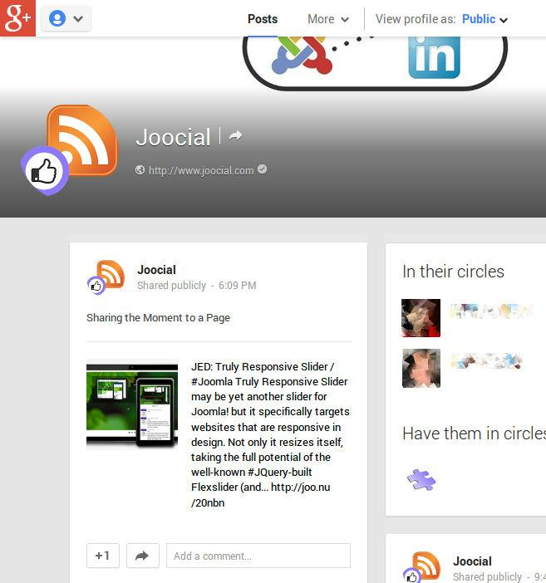
A Google+ Moments channel
How it works:
Moments can be shared to a Profile or a Page
They can only be shared manually.

Slide 10
A Google+ Moments channel
Pros:
Content is published from Joomla
There’s a clear track of content to be shared.
Less work
Better quality than no posts at all.
Cons:
Community manager has to review and share
The task can’t be automated or scheduled

Slide 11
How to configure
Access Google APIs Console to create the Apphttps://developers.google.com/console
Activate Google Plus

Slide 12
How to configure
3. Take note of your Developer Key (Permissions)

Slide 13
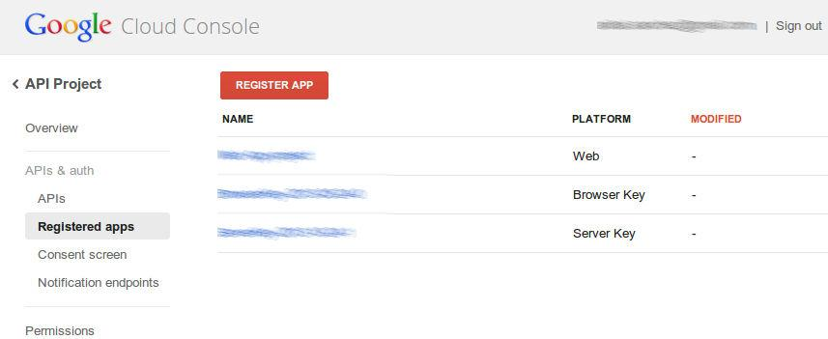
How to configure
4. Register a New App
5. Fill the Redirect Uri, and Generate

Slide 14
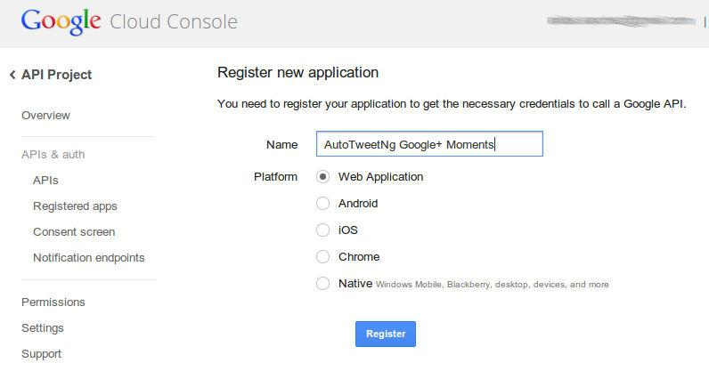
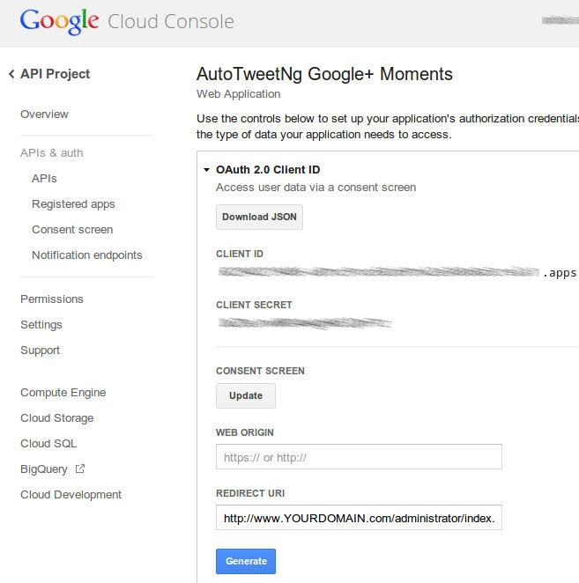
How to configure
4. Register a New App
5. Fill the Redirect Uri, and Generate
REDIRECT URI: http://www.YOURDOMAIN.com/administrator/index.php?option=com_autotweet

Slide 15
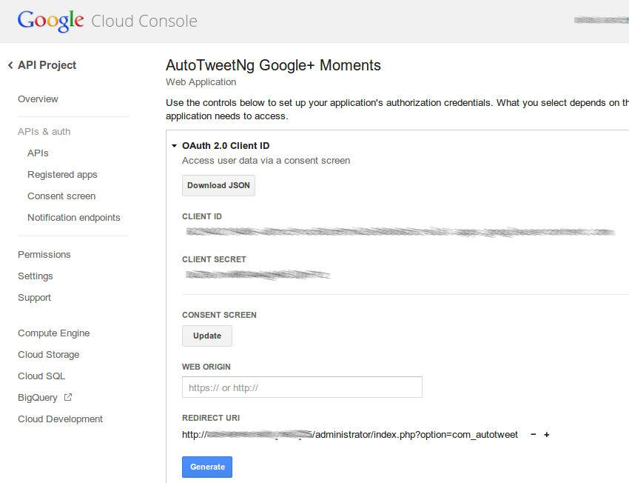
How to configure
6. Take note of Client Id and Client Secret
REDIRECT URI: http://www.YOURDOMAIN.com/administrator/index.php?option=com_autotweet

Slide 16
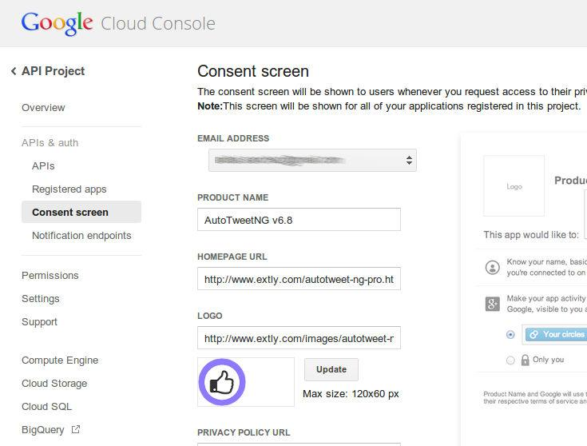
How to configure
7. Customize the consent screen
REDIRECT URI: http://www.YOURDOMAIN.com/administrator/index.php?option=com_autotweet

Slide 17
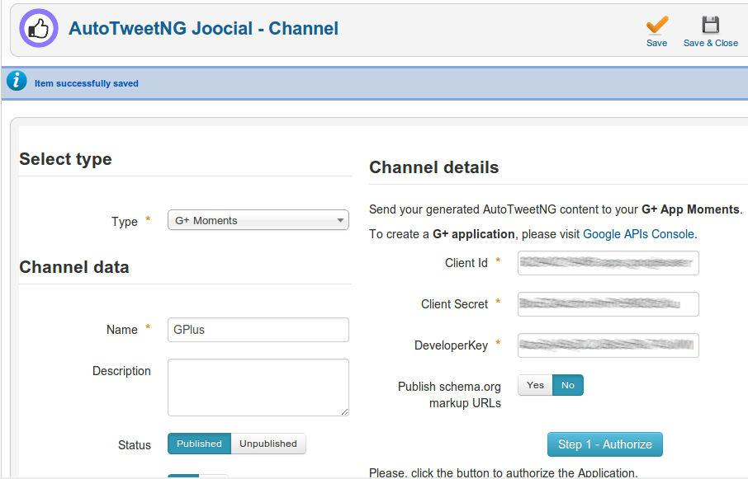
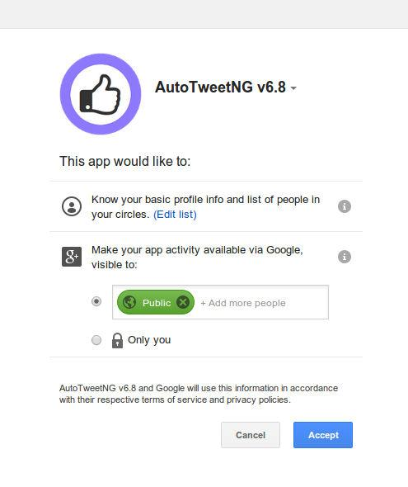
How to configure
Create the channel, save, and authorize.

Slide 18
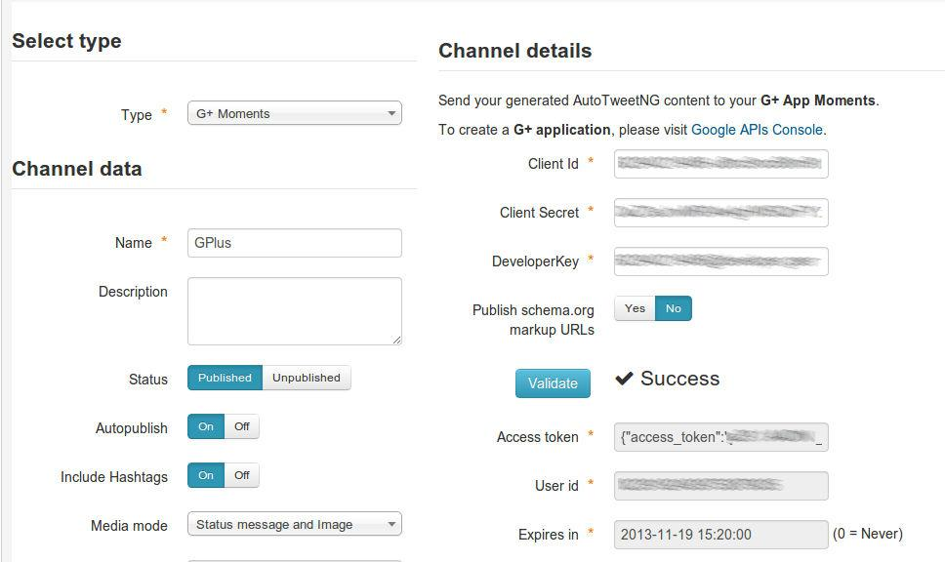
How to configure
Validate and finally save it.

Slide 19
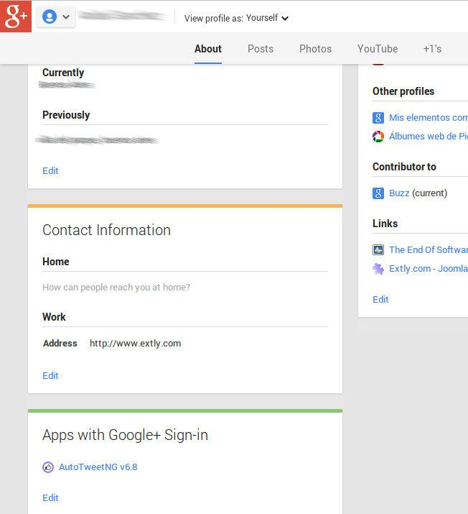
Publishing to Google+
Test some articles publication to your User profile
Access your moments, and share
Access your moments as a Page user, and share to the Page
Reference case:https://plus.google.com/+Extly

Slide 20
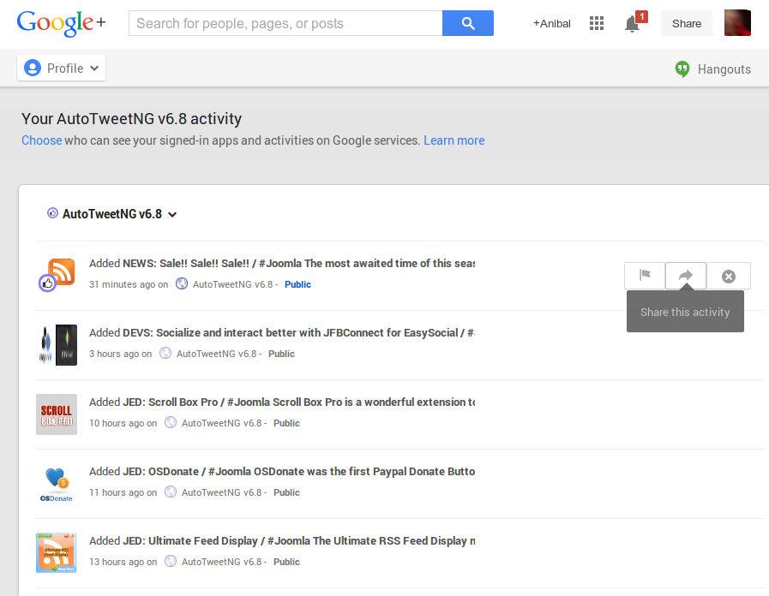
Publishing to Google+
Test some articles publication to your User profile
Access your moments, and share
Access your moments as a Page user, and share to the Page
Reference case:https://plus.google.com/+Extly

Slide 21
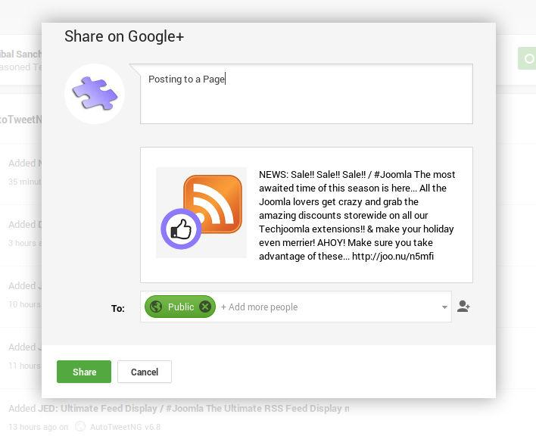
Publishing to Google+
Test some articles publication to your User profile
Access your moments, and share
Access your moments as a Page user, and share to the Page
Reference case:https://plus.google.com/+Extly

Slide 22
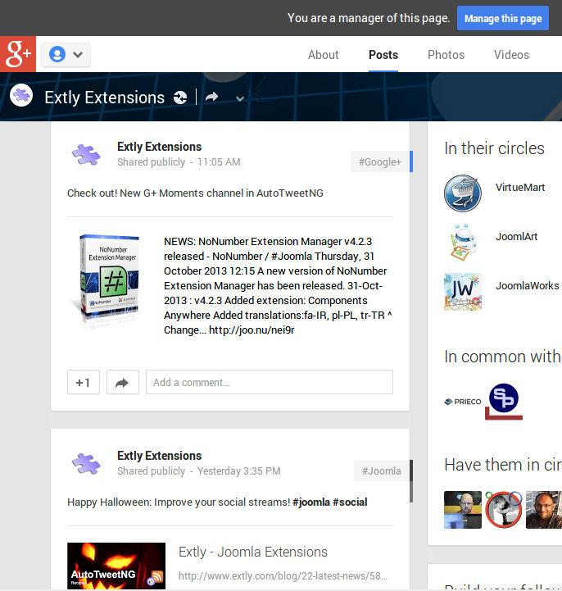
Publishing to Google+
Test some articles publication to your User profile
Access your moments, and share
Access your moments as a Page user, and share to the Page
Reference case:https://plus.google.com/+Extly

Slide 23
Social Media Strategy
Conclusion: Increased Google+ activity, and high timeline quality across networks.

Slide 24
One last word
We love your feedback, it's our way to improve.
This presentation was created with your help.
Please post a rating and a review at the #JED
It really helps ;-)
Support: http://support.extly.com Community Forum Support: http://www.extly.com/forum/index.html
Twitter @extly
Facebook facebook.com/extly

