Slide 1
Joocial
AutoTweetNG - Enhance your social media management
Full social content management in Joomla
http://www.extly.com/joocial-full-social-content-management-in-joomla.html
Presentation based on Joomla 3 and AutoTweetNG Joocial 7.1.0 2014-01-24

Slide 2
Joocial - Manage your social networks in Joomla
Beyond the original AutoTweetNG scope, Joocial is here to provide full social content management for Joomla.
Joocial includes all backend AutoTweetNG auto-posting features + publishing features to empower social media management for general users in Joomla.
Product Page: http://www.extly.com/autotweet-ng-pro.html
Support: http://support.extly.com Community Forum Support: http://www.extly.com/forum/index.html

Slide 3
Joocial - Manage your social networks in Joomla
Prerequisites
AutoTweetNG Joocial v7.1, or superior
System requirements:
- Joomla 2.5 / Joomla 3
- PHP 5.3, or superior
- MySQL 5.5, or superior (recommended)
Recommended tutorials:
How to AutoTweet from Joomla in 5 minutes
How to AutoTweet from Your Own Facebook App
Improve your social streams with RSS Feeds
Publishing to Google+ Profiles and Pages

Slide 4
Joocial - Manage your social networks in Joomla
What’s new
Social Publishing Management New tools to create, edit, schedule, and repeat posts.
Virtual Social Media Manager High-level virtual assistant to manage when Posts are published, and evergreen posts support (re-publishing).
Jootool - Front-end Social Management Team Front-end team tool to configure channels, browse, manage content requests and posts.

Slide 5
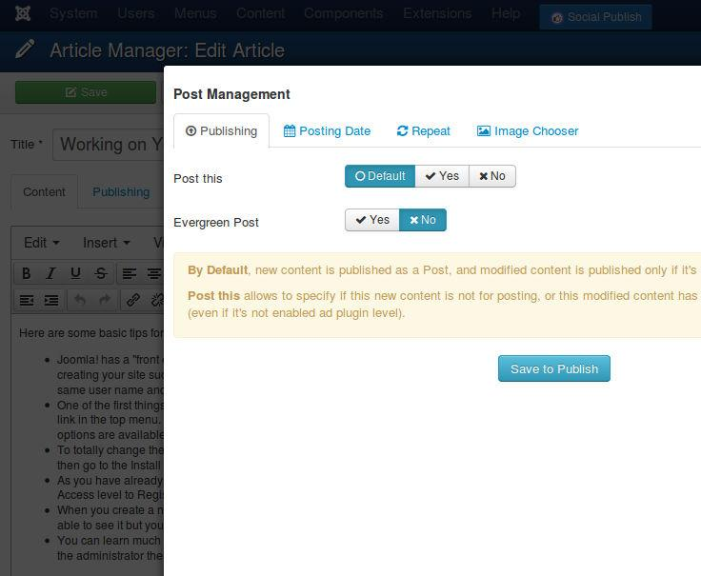
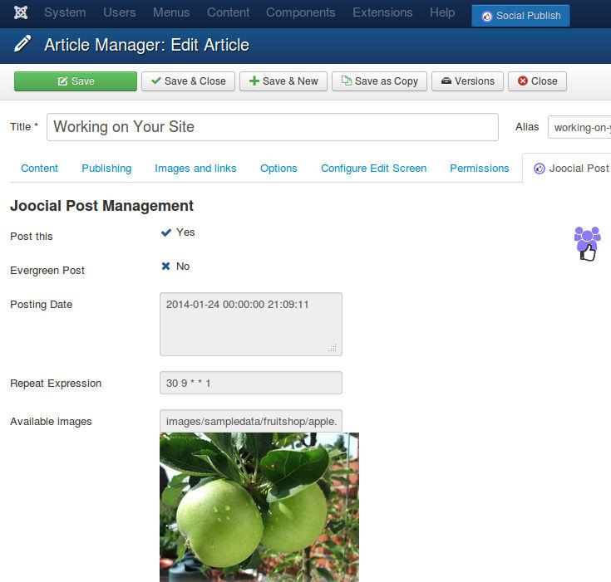
Joocial - Manage your social networks in Joomla
Social Publishing Management
Social Publishing Management: beyond auto-posting content, Joocial introduces tools at component item level to define specific properties.

Slide 6
Joocial - Manage your social networks in Joomla
Social Publishing Management
Post Management is available in the integrated components
Integrated with Joomla Articles, EasyBlog, FlexiContent, JoomShopping, K2, SobiPro, Zoo, and more.

Slide 7
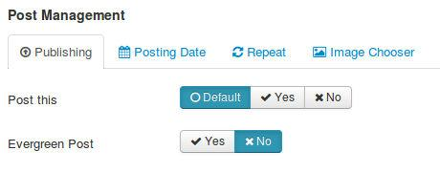
Joocial - Manage your social networks in Joomla
Social Publishing Management
Post This: Allows to force publishing this post (when it’s generally excluded), or do not post it (when it’s generally included)
Evergreen Post: Check it to mark the post as evergreen (virtual management can re-publish it)

Slide 8
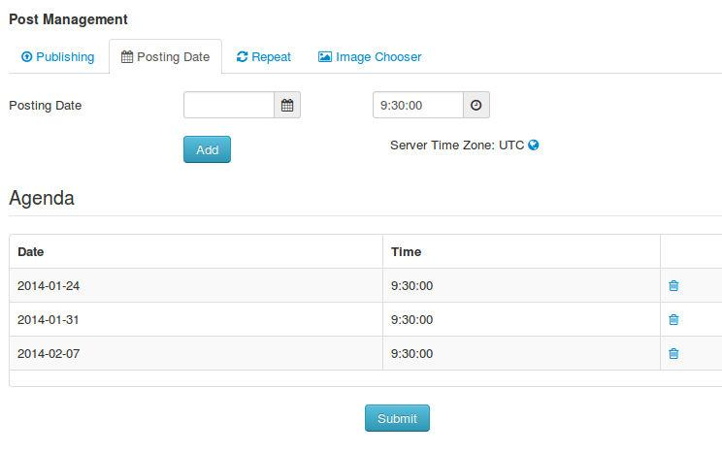
Joocial - Manage your social networks in Joomla
Social Publishing Management
Posting Date: Schedule when the Post must be published, and a sequence of re-publications.

Slide 9
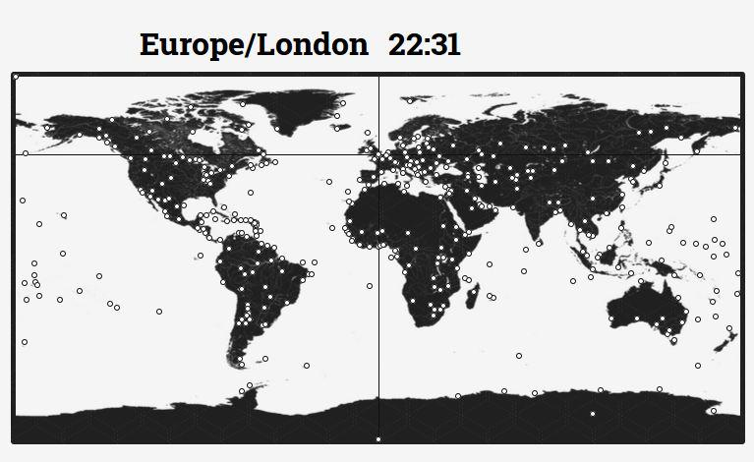
Joocial - Manage your social networks in Joomla
Social Publishing Management
About World Clock & Time Zone Map: all times are related to the server time zone. Please, remember to adjust it according to your audience.

Slide 10
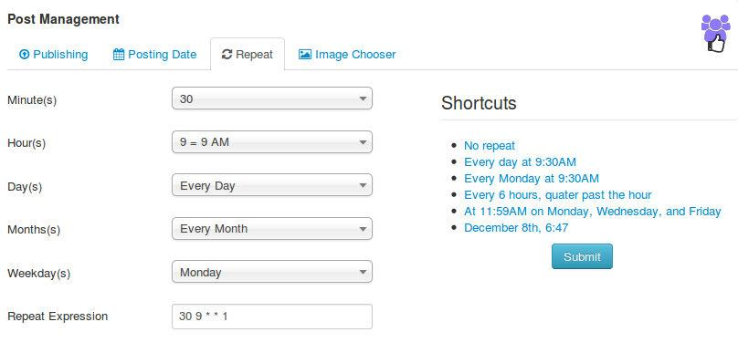
Joocial - Manage your social networks in Joomla
Social Publishing Management
Repeat: Define a frequency of repetitions for this post.
It can start right away, or you can define a first posting date. To stop it, you must cancel the content request.

Slide 11
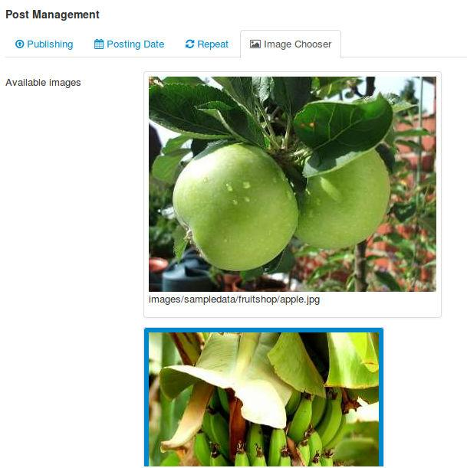
Joocial - Manage your social networks in Joomla
Social Publishing Management
Image Chooser: Select which article image must be included in Post.
If no image is chosen, Post is created with the first available image.

Slide 12
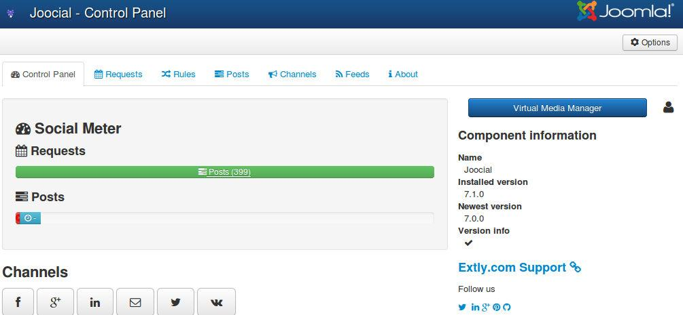
Joocial - Manage your social networks in Joomla
Virtual Social Media Manager
Virtual Media Manager: Provides a virtual assistant to support high level operations:
Only publish in “working hours”
If there’s nothing new to publish from site or RSS Feeds, re-publish “evergreen” content

Slide 13
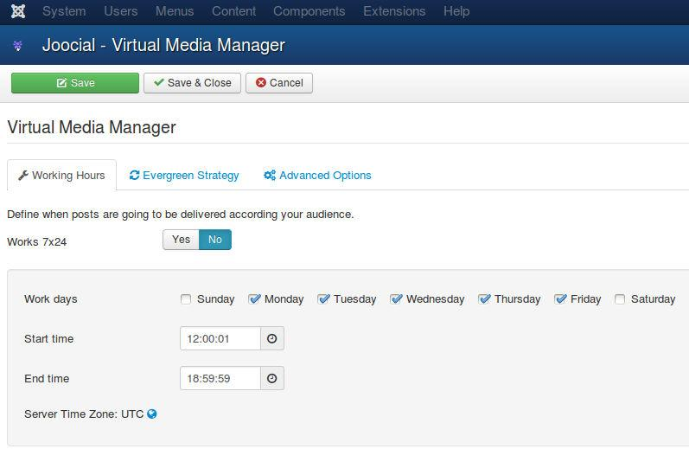
Joocial - Manage your social networks in Joomla
Virtual Social Media Manager
Working Hours: Define to allow Post publication at any time, or focused in a period of time.
E.g. You can receive new articles with RSS Feeds, and filter them according your audience. But if your users are more active at some hours, you can define the “working hours” to your Virtual manager.

Slide 14
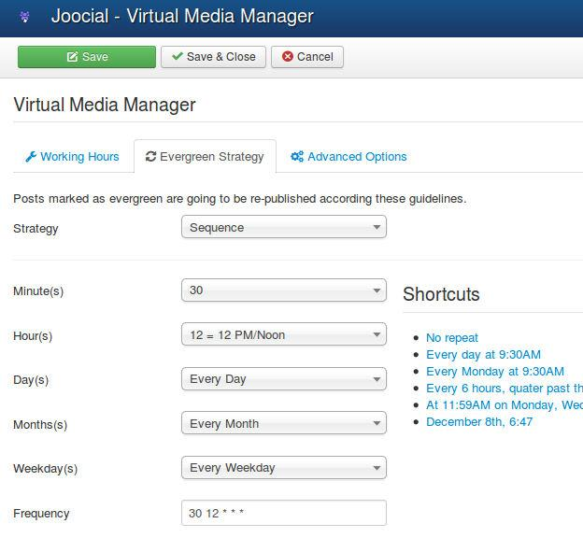
Joocial - Manage your social networks in Joomla
Virtual Social Media Manager
Evergreen Posts: Posts selected as evergreen can be posted if there’s no content available. In this form, you can define frequency of evergreen posts.
Strategy: It can be random or in sequence. In both cases, a great number of evergreen posts is recommended to avoid channel saturation.
Reference: Should bloggers and businesses share old content?

Slide 15
Joocial - Manage your social networks in Joomla
Virtual Social Media Manager
Evergreen Posts: Posts selected as evergreen can be posted if there’s no content available. In this form, you can define frequency of evergreen posts.
Strategy: It can be random or in sequence. In both cases, a great number of evergreen posts is recommended to avoid channel saturation.
Reference: Should bloggers and businesses share old content?

Slide 16
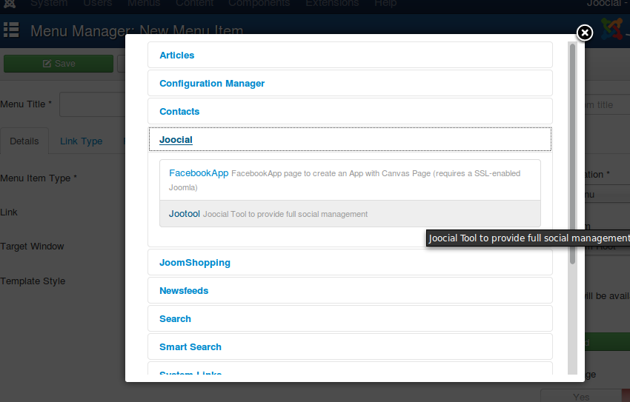
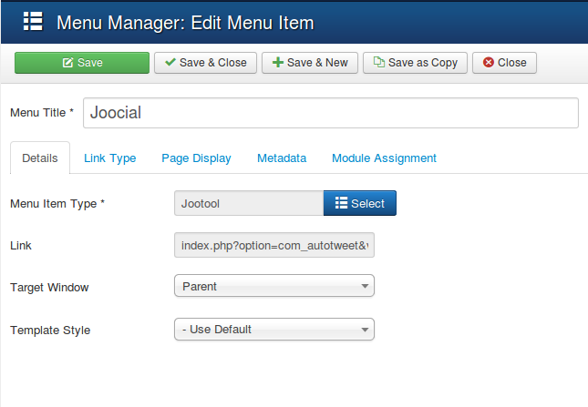
Joocial - Manage your social networks in Joomla
Front-end Social Management Team
Jootool: It’s a new front-end solution for your social management team.
To start, please create a new Menu Item for Joocial

Slide 17
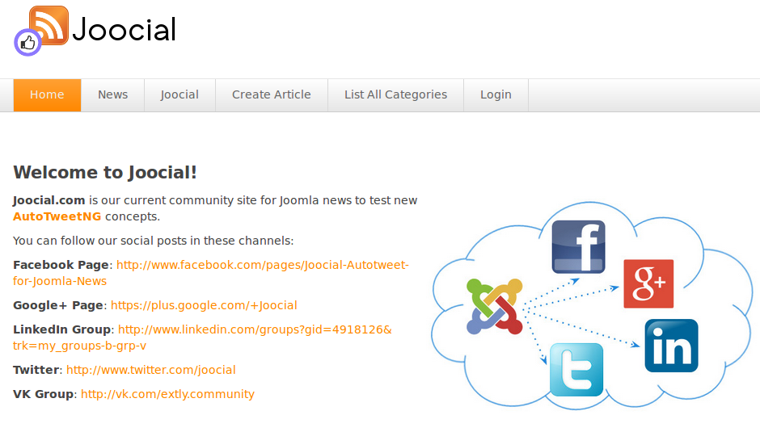
Joocial - Manage your social networks in Joomla
Front-end Social Management Team
Jootool: It’s a new front-end solution for your social management team.
This example is based on Joomla! Content Manager

Slide 18
Joocial - Manage your social networks in Joomla
Front-end Social Management Team
In Joomla!, you can have several User Groups (*).
By default, Jootool allows these operations:
User | Create | Edit Own | Edit | Edit State | Delete | Access Backend | Configuration
Author | ok | ok
Editor | ok | ok | ok
Publisher | ok | ok | ok | ok
Manager | ok | ok | ok | ok | ok
Administrator | ok | ok | ok | ok | ok | ok
Super User | ok | ok | ok | ok | ok | ok | ok
(*) For further information: http://docs.joomla.org/ACL
Permissions can be customized by Administrator in Global Configuration

Slide 19
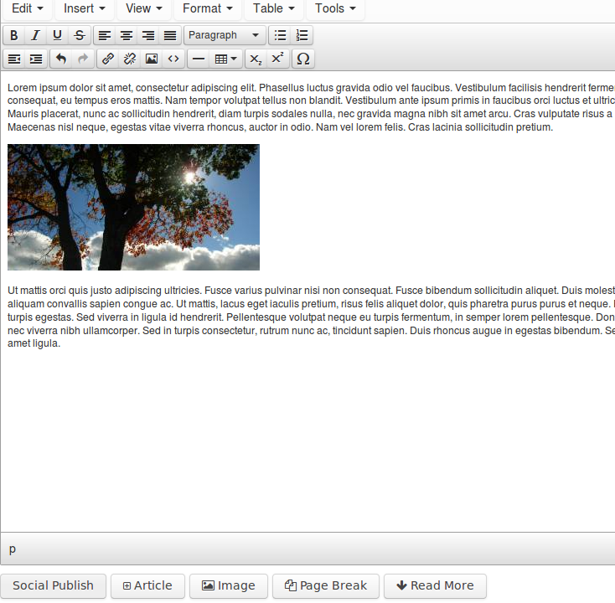
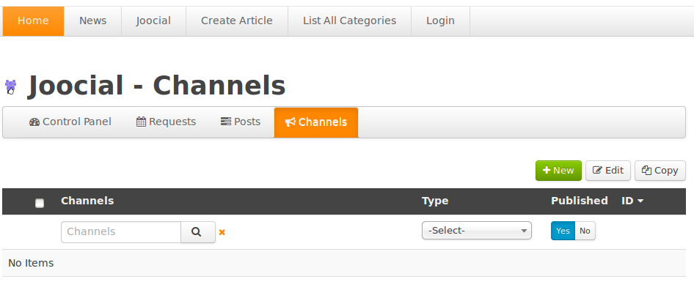
Joocial - Manage your social networks in Joomla
Front-end Social Management Team
Author:
Create content and Edit Own “Social Publishing” Options
Create and Edit own channels.

Slide 20
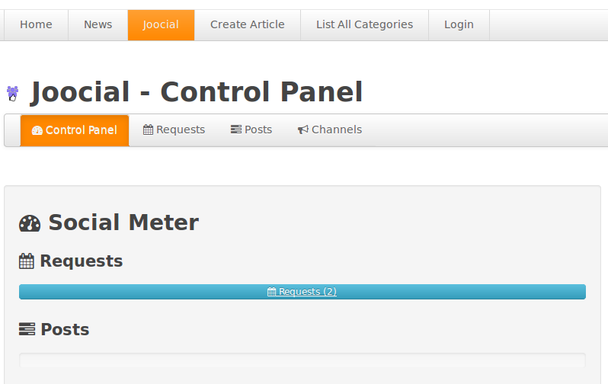
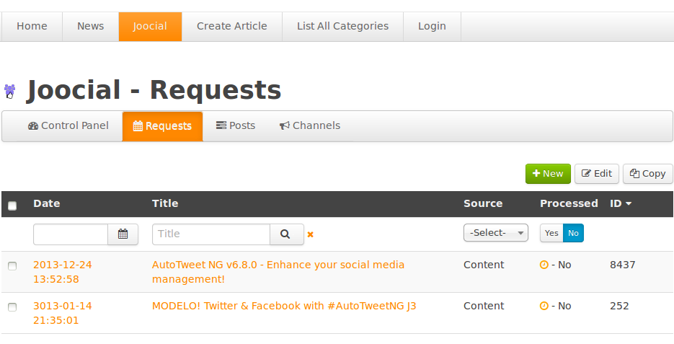
Joocial - Manage your social networks in Joomla
Front-end Social Management Team
Editor:
Create and Edit content, Edit “Social Publishing” Options
Create and Edit channels.
Requests and Posts: Check Status

Slide 21
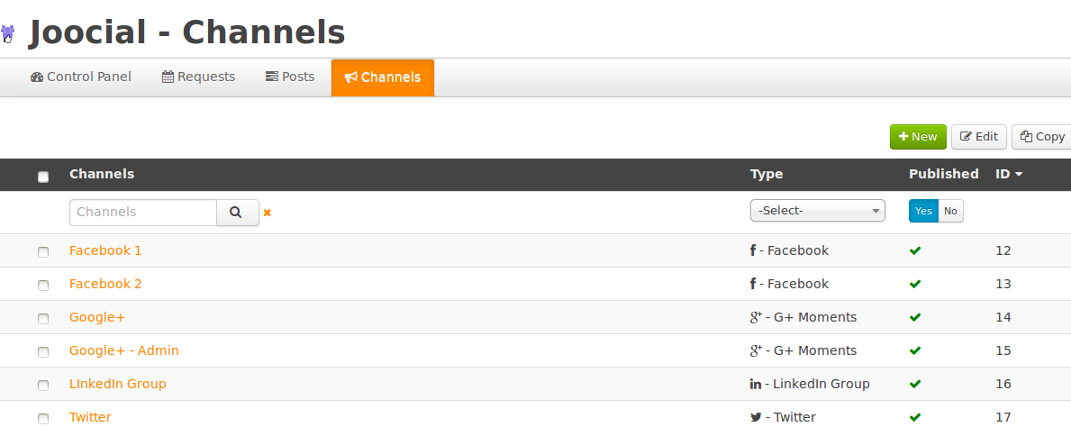
Joocial - Manage your social networks in Joomla
Front-end Social Management Team
Editor:

Slide 22
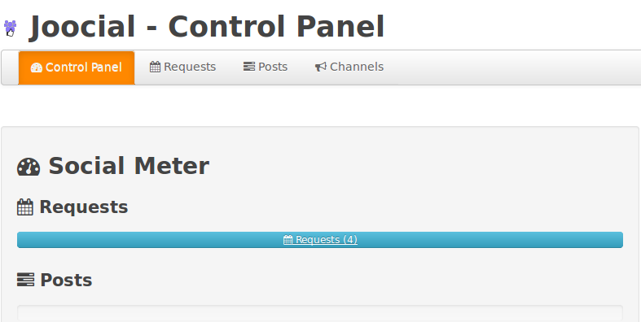
Joocial - Manage your social networks in Joomla
Front-end Social Management Team
Publishers:
Create, Edit and Edit State content, Edit “Social Publishing” Options
Create, Edit and Publish channels.
Requests and Posts: Check Status, Process and Publish

Slide 23
Joocial - Manage your social networks in Joomla
Front-end Social Management Team
Publishers:

Slide 24
Joocial - Manage your social networks in Joomla
Front-end Social Management Team
Managers:
Create, Edit andEdit State content, Edit “Social Publishing” Options
Create, Edit, Publish and Delete channels.
Requests and Posts: Check Status, Process, Publish and Delete

Slide 25
Joocial - Manage your social networks in Joomla
Front-end Social Management Team
Managers:

Slide 26
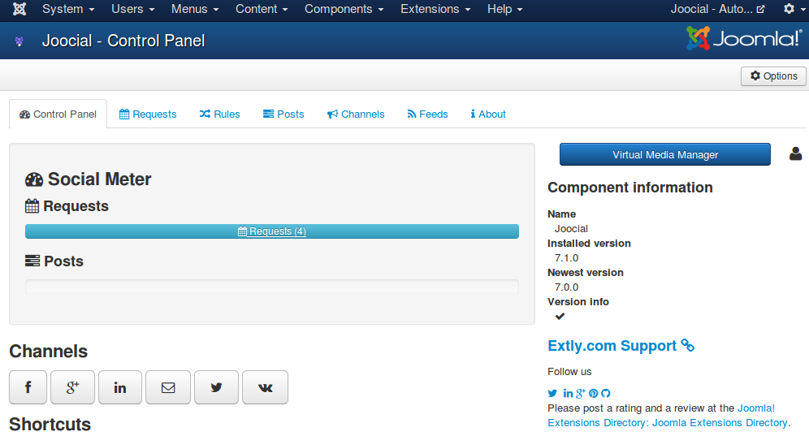
Joocial - Manage your social networks in Joomla
Front-end Social Management Team
Administrators and Super Users:
Create, Edit and Edit State content, Edit “Social Publishing” Options
Create, Edit, Publish and Delete channels.
Requests and Posts: Check Status, Process, Publish and Delete
Access Administration Interface, Feeds and Virtual Media Manager

Slide 27
Joocial - Manage your social networks in Joomla
Conclusion
In this presentation, we have shown the new features available in Joomla for full social content management:
Social Publishing Management: New tools to create, edit, schedule, and repeat posts.
Virtual Social Media Manager: High-level virtual assistant to manage when Posts are published, and evergreen posts support (re-publishing).
Jootool - Front-end Social Management Team: Front-end team tool to configure channels, browse, manage content requests and posts.

Slide 28
One last word
We love your feedback, it's our way to improve.
This presentation was created with your help.
Please post a rating and a review at the #JED
It really helps ;-)
Support: http://support.extly.com Community Forum Support: http://www.extly.com/forum/index.html
Twitter @extly
Facebook facebook.com/extly

