Slide 1
XTDir for SobiPro
SobiPro and PayPlans Membership Management
Presentation based on Joomla 3, SobiPro 1.1 and XTDir 5.4
2014-06-17

Slide 2
XTDir for SobiPro
In this presentation, we are going to show how you can:
extend a SobiPro directory with XTDir,
manage subscriptions with PayPlans,
and promoted entries with XTDir

Slide 3
XTDir for SobiPro - PayPlans
Prerequisites
XTDir v5.4, or superior
SobiPro v1.1, or superior
PayPlans v3, or superior
Joomla v2.5 / v3, or superior
MySQL 5.5 (recommended), or superior
PHP 5.3, or superior

Slide 4
XTDir for SobiPro - Installation
In this tutorial, we’ve assumed you have a working XTDir for SobiPro installation.
To review the installation steps, visit:
XTDir - How to extend your directory
XTDir - Building an advertising catalog for Joomla!

Slide 5
PayPlans - Creating Plans to Sell
PayPlans is a membership software for selling your services online & provides automatic subscription and effortless billing management. PayPlans is everything you need to create an exceptional online membership system.
Beautiful & Clean Interface
Responsive Design
Ultimate Flexibility
100% Open-Source

Slide 6
XTDir for SobiPro and PayPlans
How it works:
XTDir Promotions for SobiPro are assigned according to Joomla User Groups.
E.g. “Premium Subscribers”
PayPlans manages assigned User Group according to the membership status.
In the following steps, we are showing how to:
Create a Joomla User Group
Create a PayPlan Plan, Payment Gateway, and customize a “Joomla User Type” App Instance
Create a XTDir User Group Promotion
Test a payment and verify an assigned membership

Slide 7
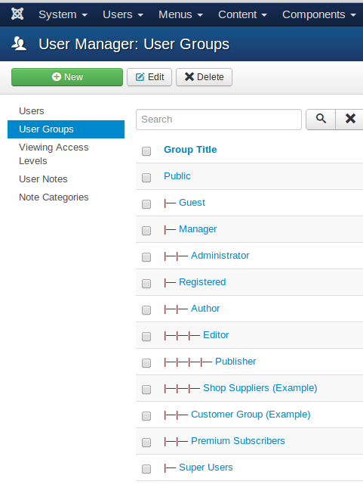
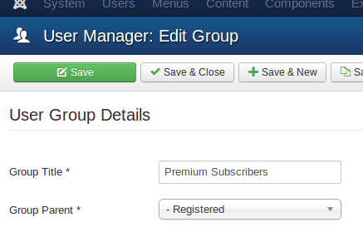
Joomla - Creating a User Group
Go to Website Backend > Users > Groups > New.
Create a new user group “Premium Subscribers”.

Slide 8
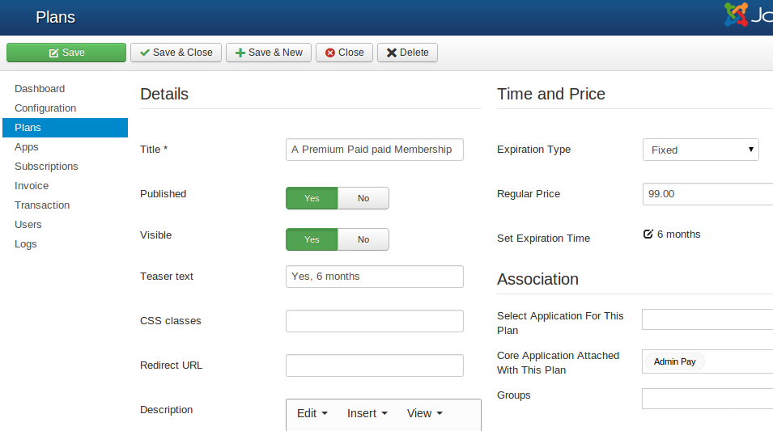
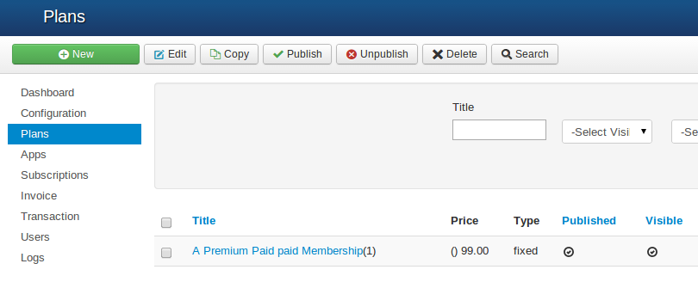
PayPlans - Creating Plans to Sell
First, you need to create Plans to sell your membership.
Go to the Plans tab of PayPlans.
You can follow the steps given for creating plans.
To show plans to customer you need to create a menu. (This step have been added in setup-checklist, you can do it by a single click)

Slide 9
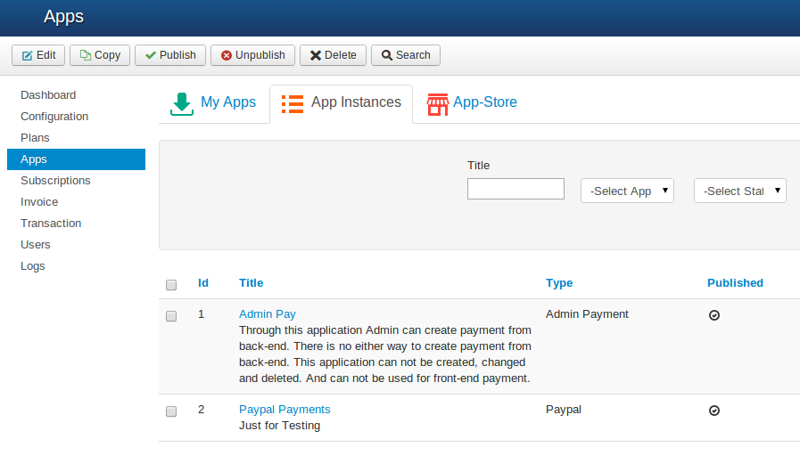
PayPlans - Setting up a Payment Gateway
To process online payments automatically Payment gateway is required. PayPlans has integration with many popular payment gateways.
Go to Website Backend > PayPlans > App-Manager > Search and install required payment gateway Apps.
Go to the Website Backend > PayPlans > Apps tab, and create a new app.
Select your choice of payment gateway from the available list.
Fill your account details of the payment gateway and give a name to the app.

Slide 10
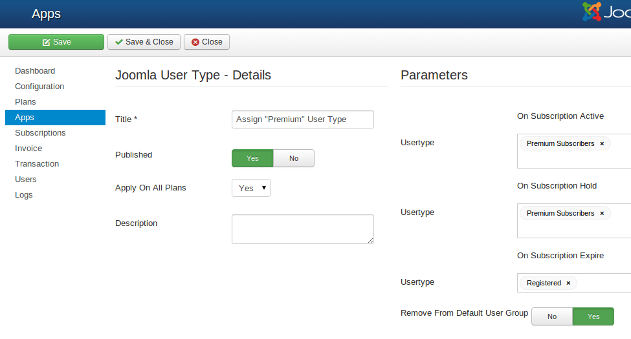
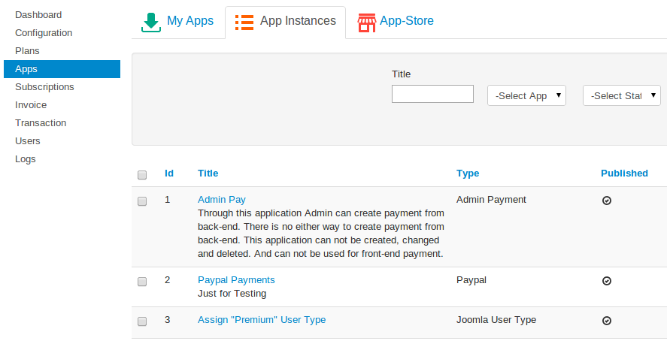
PayPlans - “Joomla User Type”
Customize a “Joomla User Type” App Instance.
Go to Website Backend > PayPlans > App-Manager > Search and install “Joomla User Type” App Instance.
Fill the User Group details and give a name to the app.

Slide 11
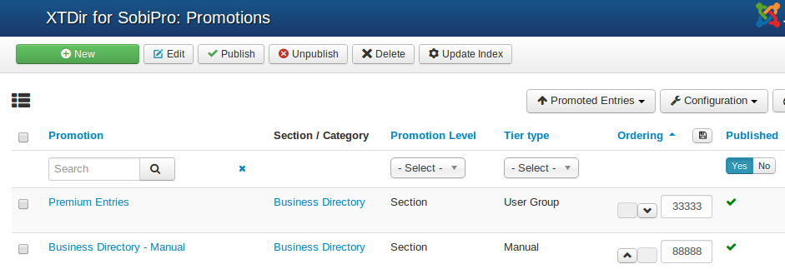
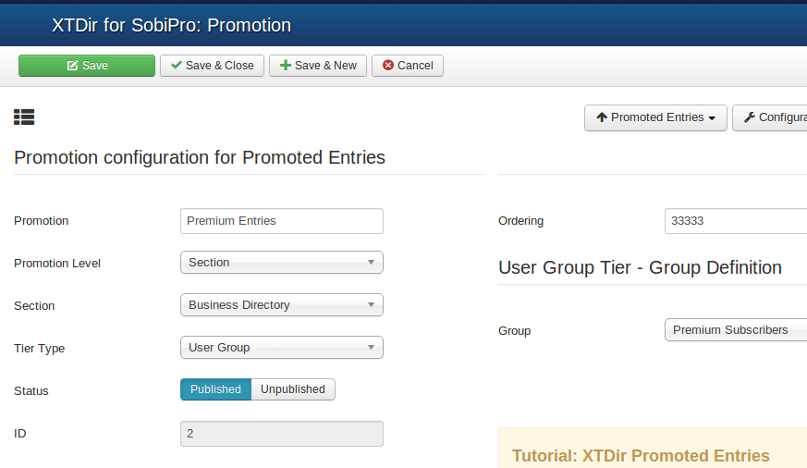
XTDir - User Group Promotion
Go to Website Backend > XTDir > Promotions
Create a new Promotion
Fill Promotion details, and select “User Group” type, and the specific group.

Slide 12
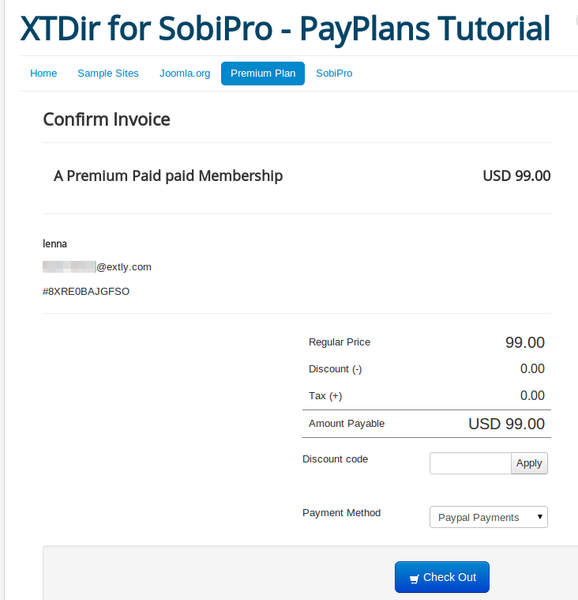
XTDir for SobiPro - PayPlans A Membership Case
Fill an Invoice
Receive a Transaction
Verify Subscription Status
Verify User Group Assignment
Check Promotion Assignment
Browse the new featured entry

Slide 13
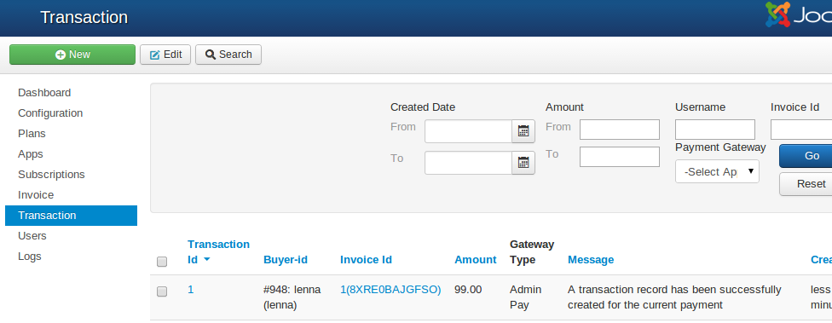
XTDir for SobiPro - PayPlans A Membership Case
Fill an Invoice
Receive a Transaction
Verify Subscription Status
Verify User Group Assignment
Check Promotion Assignment
Browse the new featured entry

Slide 14
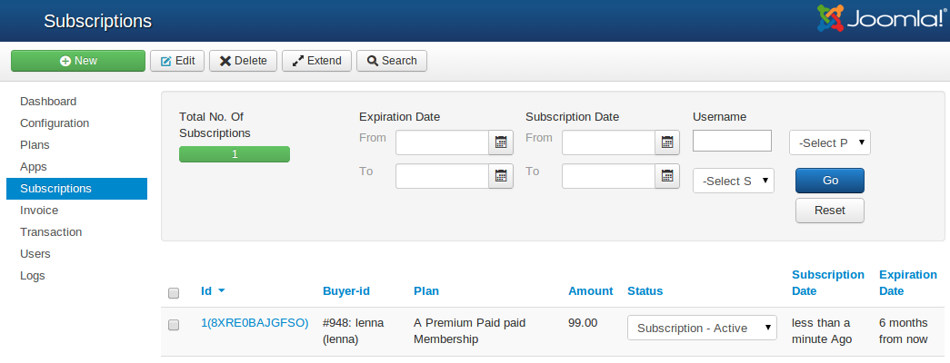
XTDir for SobiPro - PayPlans A Membership Case
Fill an Invoice
Receive a Transaction
Verify Subscription Status
Verify User Group Assignment
Check Promotion Assignment
Browse the new featured entry

Slide 15
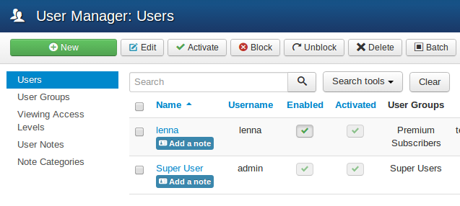
XTDir for SobiPro - PayPlans A Membership Case
Fill an Invoice
Receive a Transaction
Verify Subscription Status
Verify User Group Assignment
Check Promotion Assignment
Browse the new featured entry

Slide 16
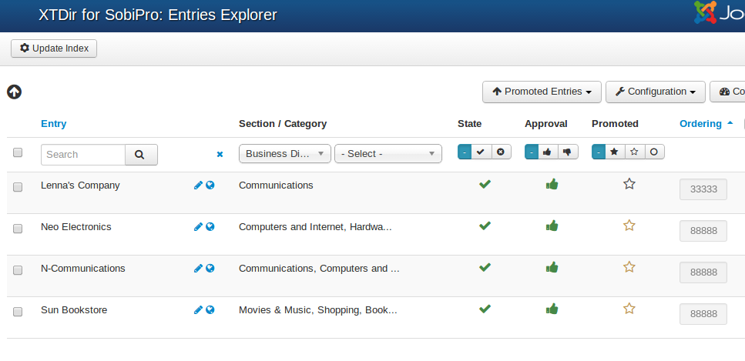
XTDir for SobiPro - PayPlans A Membership Case
Fill an Invoice
Receive a Transaction
Verify Subscription Status
Verify User Group Assignment
Check Promotion Assignment
Browse the new featured entry

Slide 17
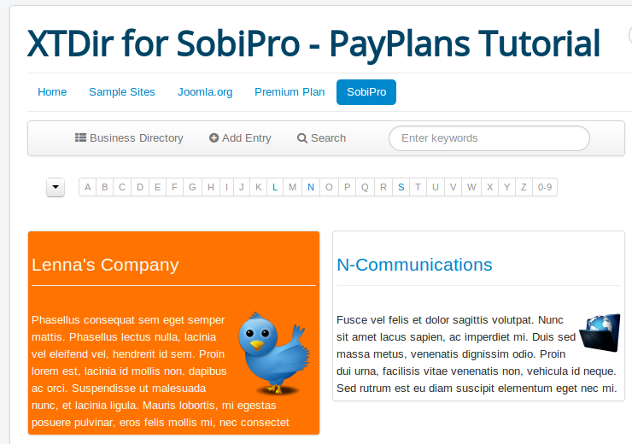
XTDir for SobiPro - PayPlans A Membership Case
Fill an Invoice
Receive a Transaction
Verify Subscription Status
Verify User Group Assignment
Check Promotion Assignment
Browse the new featured entry
NOTE: Promoted Entries can be freely customized. Shown colors and layouts are for demo purposes only.

Slide 18
One last word
We love your feedback, it's our way to improve.
This presentation was created with your help.
Please post a rating and a review at the #JED
It really helps ;-)
Support: http://support.extly.com Community Forum Support: http://www.extly.com/forum/index.html
Twitter @extly
Facebook facebook.com/extly

