Slide 1
XTDir Pages for JomSocial
Adding Pages to JomSocial Community Network
Presentation based on Joomla 3, JomSocial 3, SobiPro 1.1 and XTDir 5.0.6
2013-11-13

Slide 2
XTDir Pages for JomSocial
In this presentation, we are going to show how you can add Pages, based on SobiPro, to your Joomla! / JomSocial community network.
About JomSocial, It's the No. 1 community software for Joomla! Turn Joomla CMS into a full-fledged, Social-Networking site.
About SobiPro, SobiPro is a powerful directory component for Joomla!
http://www.extly.com/xtdir-adding-pages-to-jomsocial-community-network.html

Slide 3
About Pages
In a social network, Pages build a closer relationship between the users and their audience and customers.
Pages provide tools for business, brands or organizations.

Slide 4
Prerequisites
Prerequisites
XTDir for JomSocial 5.0.6, or superior
JomSocial 3.0.5
SobiPro 1.1, or superior (recommended)
SobiPro 1.0.8 is supported
Joomla 2.5 / 3.1 / 3.2, or superior
MySQL 5.5, or superior (recommended)
PHP 5.3, or superior

Slide 5
XTDir Pages for JomSocial
XTDir is a single component, with a set of modules and plugins, to add the most frequently requested JomSocial and SobiPro features. All configuration and management tasks are performed in a single administrative center.
My SobiPro Entries, a JomSocial app and a Joomla! module, to show SobiPro entries associated with a JomSocial user profile.
User Profile for SobiPro, a SobiPro read-only field to show JomSocial user profile in associated SobiPro entries.
SobiPro Activity Stream for JomSocial, a SobiPro App to push activities to the community wall stream (including reviews).
Extended Search Modules, modules to master the art of catalog search. Support for cookie form saving.
Categories of SobiPro Module, a module with 6-Layouts to navigate your catalog categories
Search in Categories, Search in Selected Section Modules, and Search Plugin(+) Plus, to fill all search possibilities.
CategoriesFilterApp, a SobiPro App to show a chained categories control and support empty keyword search in SobiPro.
Product Page: http://www.extly.com/jomsocial-extensions.html
Support: http://support.extly.com Community Forum Support: http://www.extly.com/forum/index.html

Slide 6
XTDir Pages for JomSocial
This presentation is focused in the social network and directory customization:
My SobiPro Entries, a JomSocial app and a Joomla! module, to show SobiPro entries associated with a JomSocial user profile.
User Profile for SobiPro, a SobiPro read-only field to show JomSocial user profile in associated SobiPro entries.
SobiPro Activity Stream for JomSocial, a SobiPro App to push activities to the community wall stream (including reviews).
The objective is to implement:
Community notifications of directory activity,
Pages access from User Profiles, and
User Profile access from directory Pages
To configure the rest of XTDir’s apps, modules, and plugins:http://www.extly.com/guides-faq/75-extensions-for-sobipro-documentation/xtdir-for-sobipro.htmlhttp://www.extly.com/xtdir-building-an-advertising-catalog-for-joomla.html

Slide 7
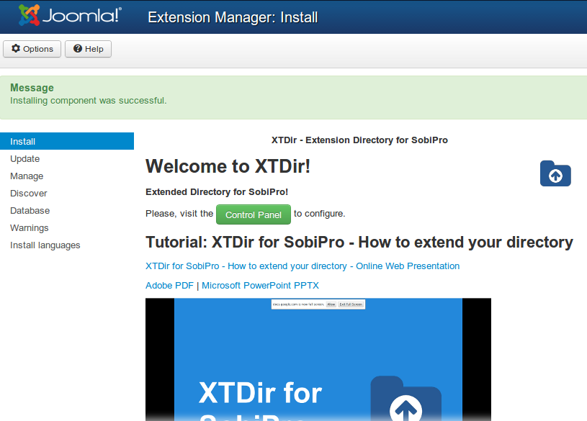
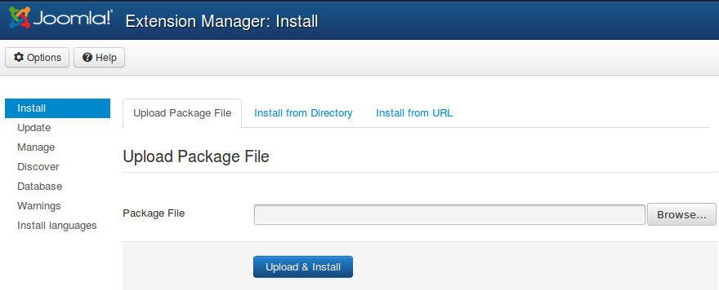
Installation
Download and install XTDir for JomSocial

Slide 8
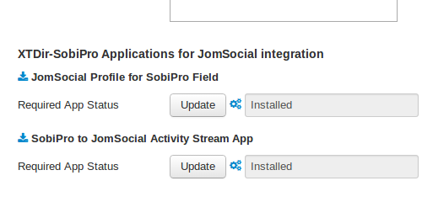
Updates
1. XTDir updates are installed in the same way
2. Remember to also update SobiPro Apps with the Update button.
"Update" buttons in XTDir / Business Pages

Slide 9
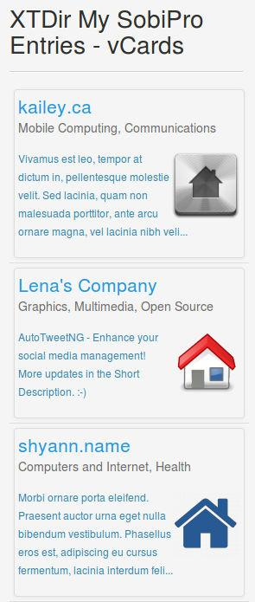
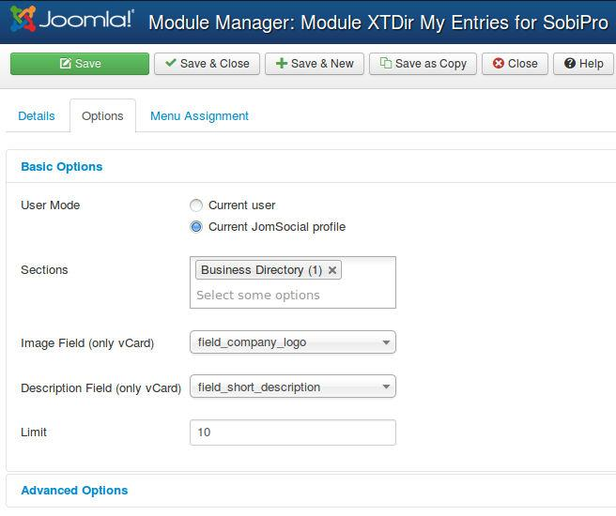
My SobiPro Entries
My SobiPro Entries module, it’s installed in the list of modules.
It can be configured in the Module Manager to a position with several control parameters.
vcard layout

Slide 10
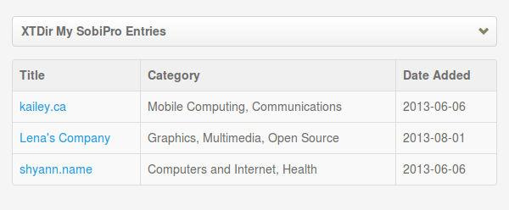
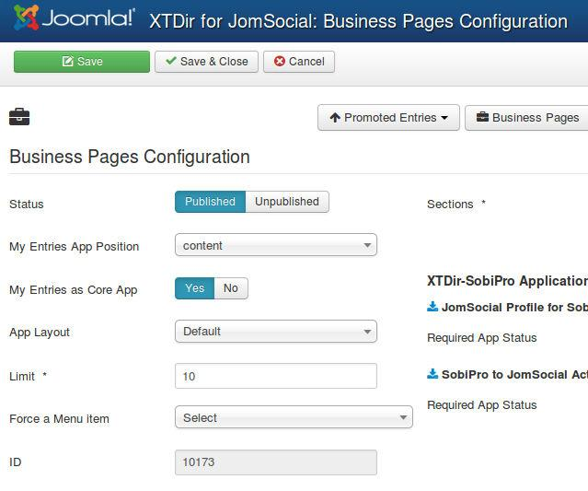
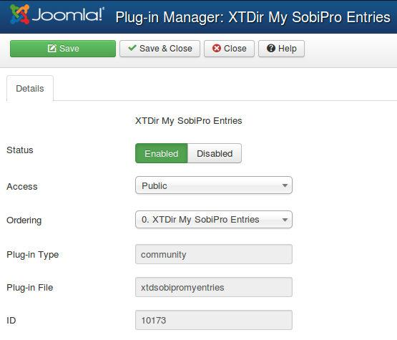
My SobiPro Entries
My SobiPro Entries app, it’s installed in the list of community plugins.
It can be enabled in the Plugin Manager with several control parameters.
Control parameters are available in Components/XTDir/Business Pages.
default layout
TIP: To change the title, you must change the language label PLG_XTDSOBIPROMYENTRIES_TITLE="XTDir My SobiPro Entries". You can change it in the language translation file, or add an override in the Language Manager.

Slide 11
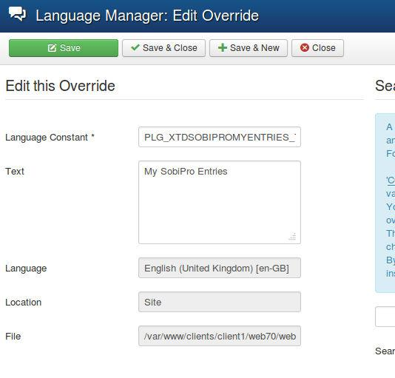
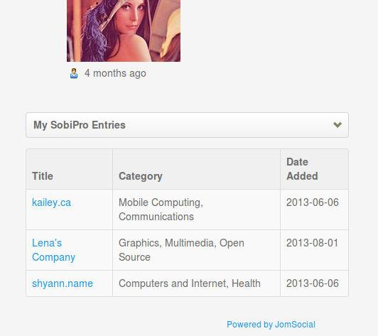
My SobiPro Entries
My SobiPro Entries app, TIP: To change the title, you must change the language label PLG_XTDSOBIPROMYENTRIES_TITLE="XTDir My SobiPro Entries".
You can change it:
In the language translation file, or
Adding an override in the Language Manager. (recommended)

Slide 12
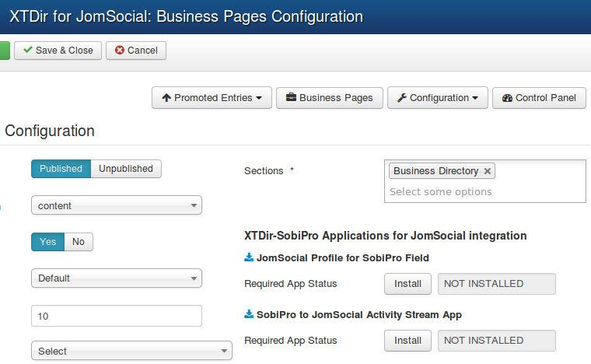
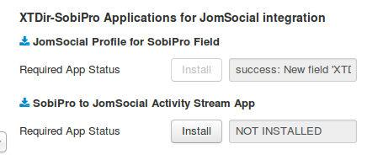
User Profile for SobiPro
XTDir Apps for SobiPro can be installed/ updated/ downloaded right from the configuration area.

Slide 13
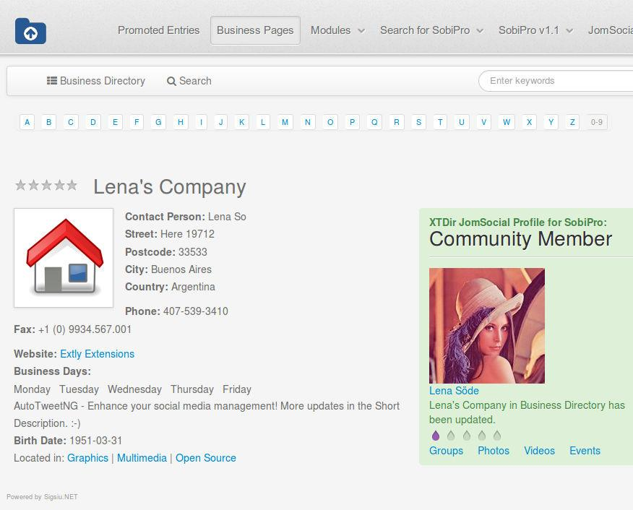
User Profile for SobiPro
User Profile for SobiPro is a SobiPro read-only field to show JomSocial user profile in associated SobiPro entries.
It can be visually customized according your template.
It’s managed as a SobiPro field.

Slide 14
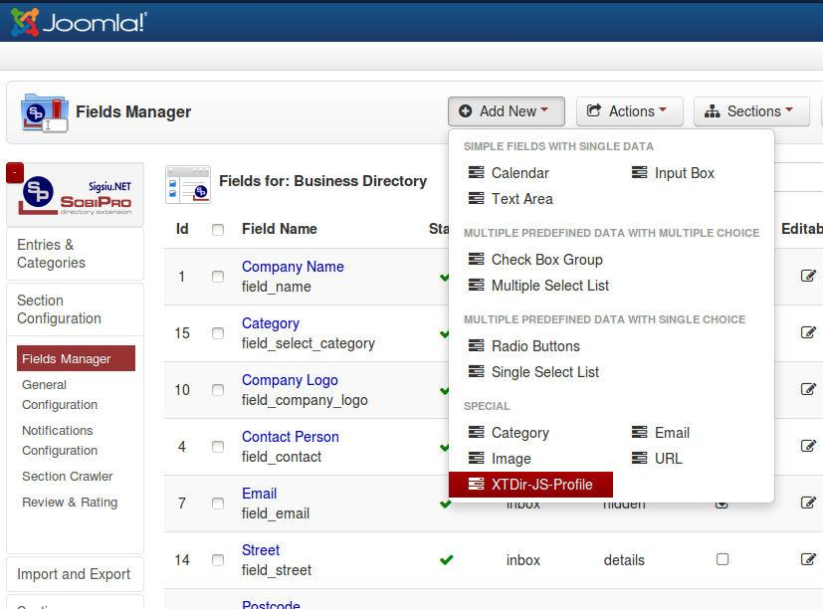
User Profile for SobiPro
To configure the User Profile for SobiPro, the field must be added to the entry structure.

Slide 15
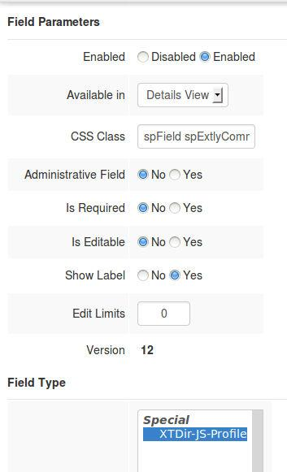
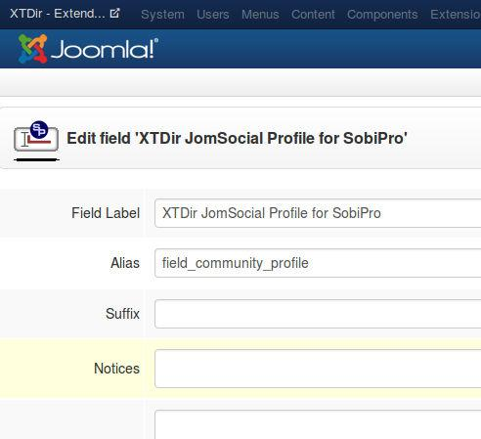
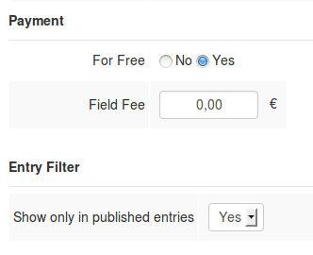
User Profile for SobiPro

Slide 16
User Profile for SobiPro
User Profile for SobiPro is shown by default with a simple style.
Sample CSS styling template customization:
.spExtlyCommunity {
float: right;
width: 300px; background-color: #DFF0D8;
border-color: #D6E9C6;
color: #468847; border-radius: 4px 4px 4px 4px;
padding: 8px 35px 8px 14px;
text-shadow: 0 1px 0 rgba(255, 255, 255, 0.5);
}
.spExtlyCommunity .groups, .spExtlyCommunity .photos, .spExtlyCommunity .videos, .spExtlyCommunity .events, .field_business_days li {
display: inline-block;
margin-right: 8px;
}
More Info: http://www.extly.com/guides-faq/41-extensions-for-jomsocial-documentation/jomsocial-user-profile-for-sobipro/472-jomsocial-user-profile-for-sobipro-documentation.html

Slide 17
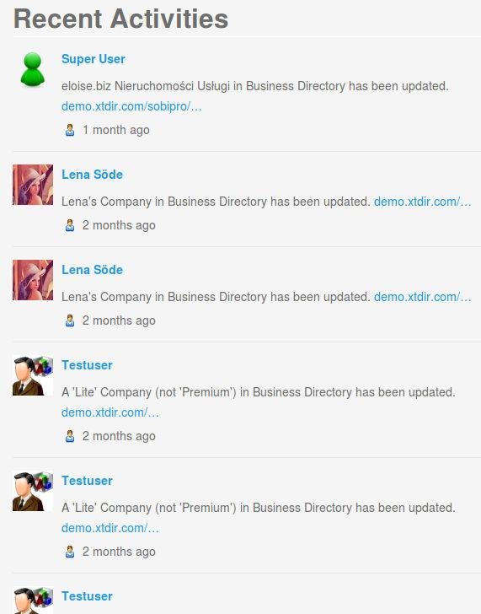
SP Activity Stream for JomSocial
SobiPro Activity Stream for JomSocial is a native SobiPro App to publish directory activities to the community wall stream (including reviews).
In this way, all community members can check what’s going on in Pages.

Slide 18
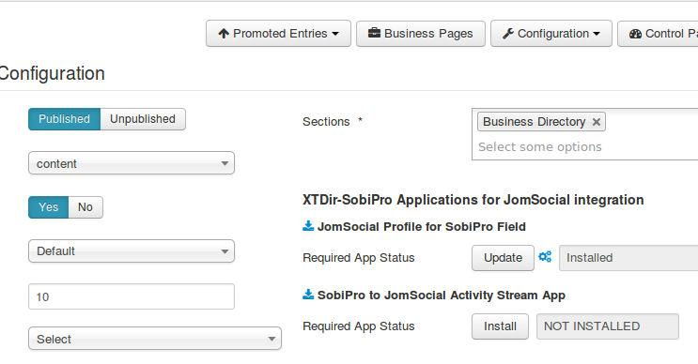
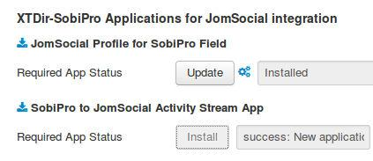
SP Activity Stream for JomSocial
SobiPro Activity Stream for JomSocial can be installed/downloaded right from the configuration area.

Slide 19
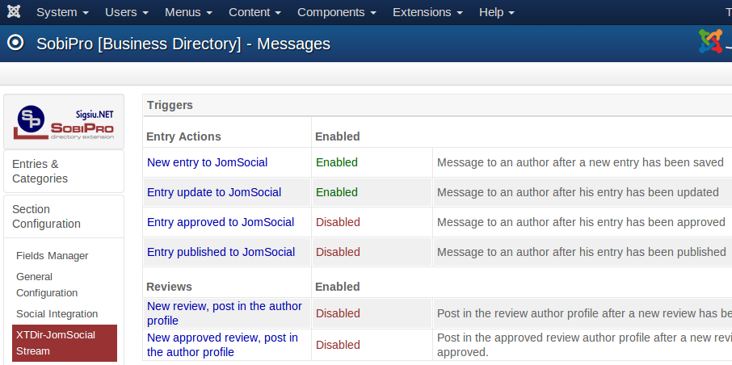
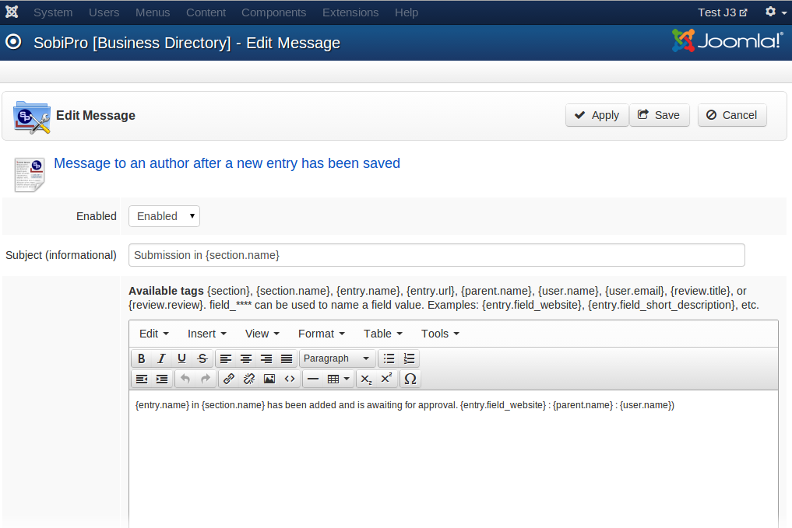
SP Activity Stream for JomSocial
SobiPro Activity Stream for JomSocial enable and configure the App at section level.

Slide 20
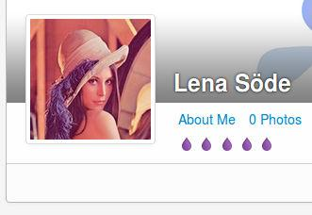
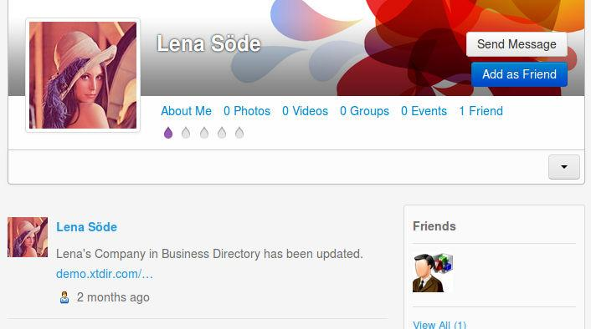
SP Activity Stream for JomSocial
User Activity is valued in JomSocial with the User Points System, and XTDir is integrated and raising specific events.
More info: http://documentation.jomsocial.com/wiki/User_Points_System

Slide 21
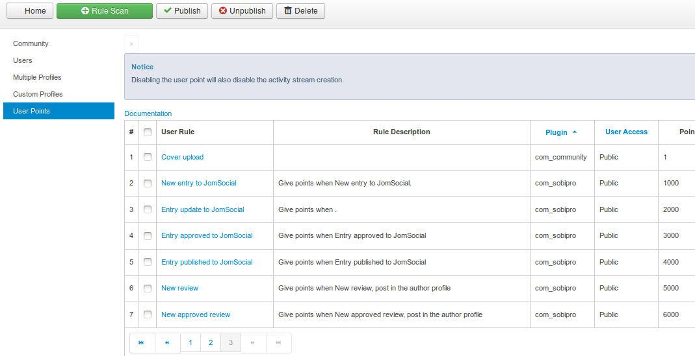
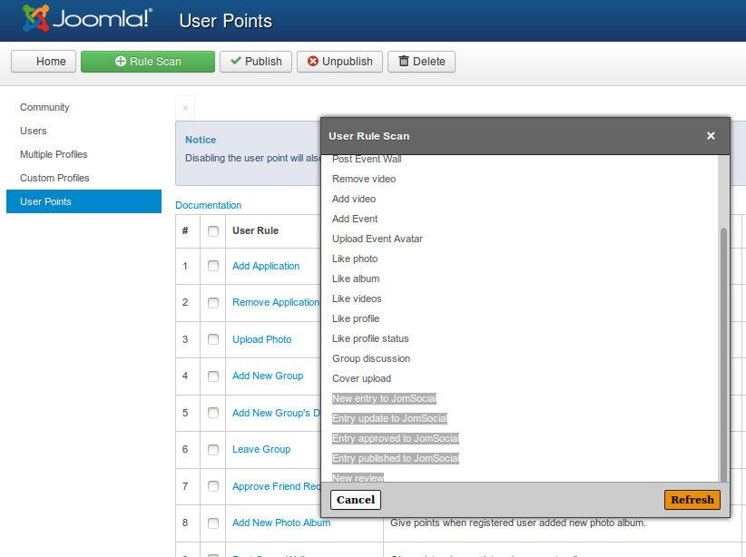
SP Activity Stream for JomSocial
To configure the User Points System, you must copy the rules file into SobiPro directory, and re-scan for new rules in JomSocial:
Copy from jomsocial_rule.xml from media/com_xtdir/rules to components/com_sobipro.
Re-scan in JomSocial / User Points
At any time, you can edit the file or change the assigned points.
More info: http://documentation.jomsocial.com/wiki/User_Points_System

Slide 22
Conclusion
In this presentation we have shown how to install and configure:
My SobiPro Entries, a JomSocial app and a Joomla! module, to show SobiPro entries associated with a JomSocial user profile.
User Profile for SobiPro, a SobiPro read-only field to show JomSocial user profile in associated SobiPro entries.
SobiPro Activity Stream for JomSocial, a SobiPro App to push activities to the community wall stream (including reviews).
In this way, navigational aids to provide Pages for JomSocial has been implemented. Users can be notified of directory activity, Pages can be accessed from a User Profile, and User Profiles can be accessed from directory Pages.

Slide 23
One last word
We love your feedback, it's our way to improve.
This presentation was created with your help.
Please post a rating and a review at the #JED
It really helps ;-)
More info: XTDir - How to extend your directoryhttp://www.extly.com/guides-faq/75-extensions-for-sobipro-documentation/xtdir-for-sobipro.html
Support: http://support.extly.com Community Forum Support: http://www.extly.com/forum/index.html
Twitter @extly
Facebook facebook.com/extly

