Slide 1
AutoTweetNG
How to AutoTweet from Joomla in 5 minutes
http://www.extly.com/how-to-autotweet-in-5-minutes-from-joomla.html
Presentation based on Joomla 3 and AutoTweetNG 7.4
2014-08-11

Slide 2
How to AutoTweet from Joomla in 5 minutes
In this presentation, we are going to show how you can AutoTweet from Joomla to Facebook, Twitter, or LinkedIn.
If you are looking for Google+ Moments channel support:www.extly.com/autotweetng-joocial-publishing-to-gplus-profiles-and-pages.html
Product Page: http://www.extly.com/autotweet-ng-pro.html
Support: http://support.extly.com Community Forum Support: http://www.extly.com/forum/index.html

Slide 3
Prerequisites
AutoTweetNG Free or PRO v7 or superior
A Facebook account
A Twitter account
A LinkedIn account
System requirements:
- Joomla 2.5 / Joomla 3.0
- PHP 5.3 or superior
- MySQL 5.5, or superior (recommended)

Slide 4
Configuration Steps
Download & Install
Create and authorize Social Channels
Add Facebook Channel
Add Twitter Channel
Add LinkedIn Channel
Create a new article to test a Post
Advanced: Posting on page load vs cronjob task
One last word

Slide 5
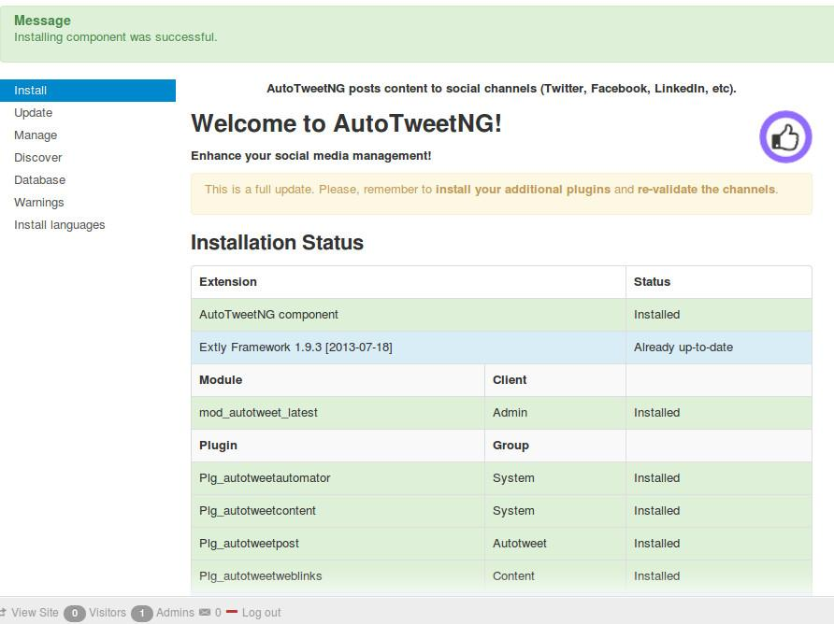
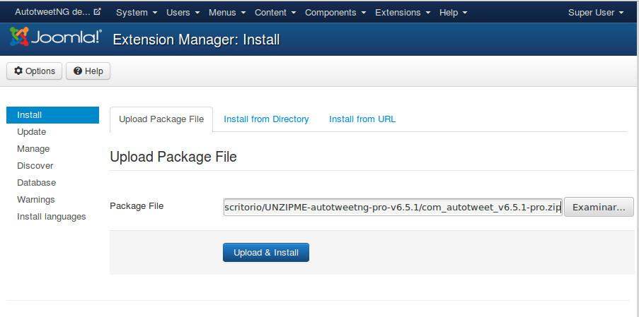
Download & Install AutoTweetNG
Download, unzip and install AutoTweetNG in Joomla backend with standard procedure.
About AutoTweetNG updates:
Install the update with the same procedure.

Slide 6
Download & Install AutoTweetNG
AutoTweetNG component has been installed.
System plugin - AutotweetAutomator has been installed and enabled, to process new content and posts every 3 minutes.
System plugin - AutotweetContent has been installed and enabled, to publish Joomla content.

Slide 7
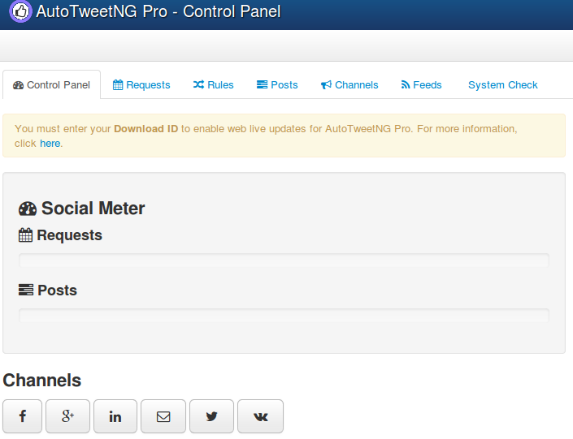
Create and authorize Social Channels
Go to AutoTweetNG Control Panel to create and authorize social channels

Slide 8
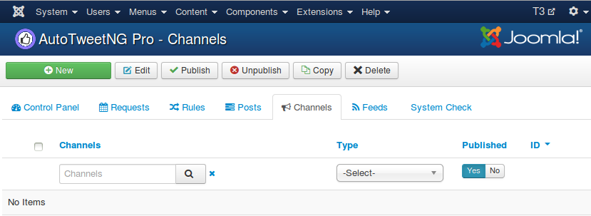
Add channel / Facebook
AutoTweetNG requires the Facebook account authorization.
Each Profile, Page or Group is a different channel.

Slide 9
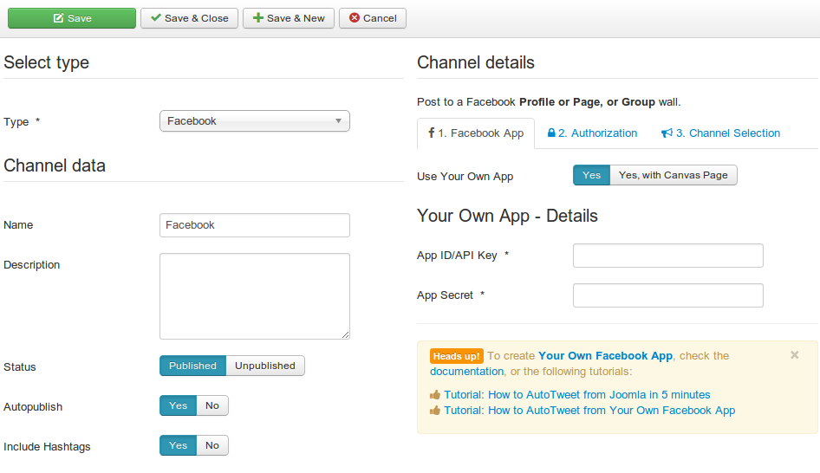
Add channel / Facebook
Assign channel type and data, and select “Use Your Own App”=Yes
Create your App
Tutorial: How to AutoTweet from Your Own Facebook App

Slide 10
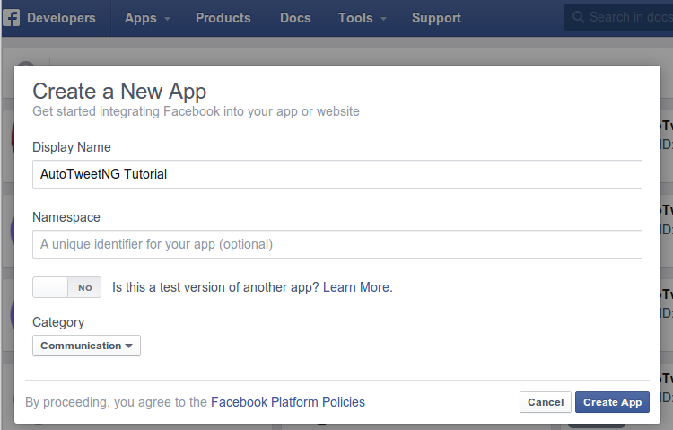
Add channel / Facebook
Create a Facebook App
Login at https://developers.facebook.com/apps with your Facebook username and password
Create New App
Define App name

Slide 11
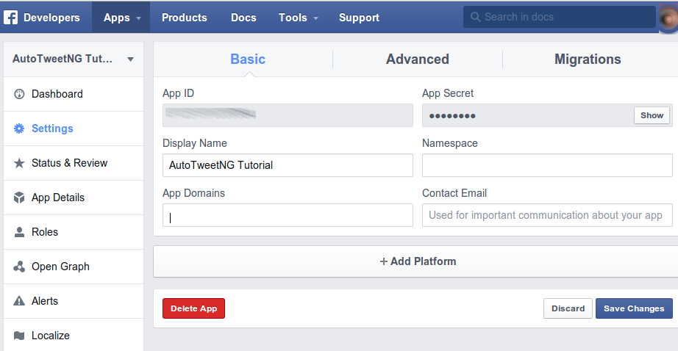
Add channel / Facebook
Create a Facebook App
Now, you have your own:
App ID
App Secret
Don’t forget to:
Fill App Domain,
Add Platform
yourdomain.com

Slide 12
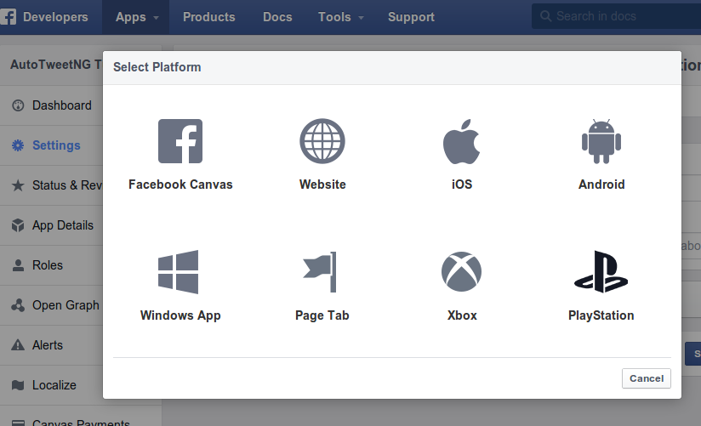
Add channel / Facebook
Create a Facebook App
Now, you have your own:
App ID
App Secret
Don’t forget to:
Add Platform

Slide 13
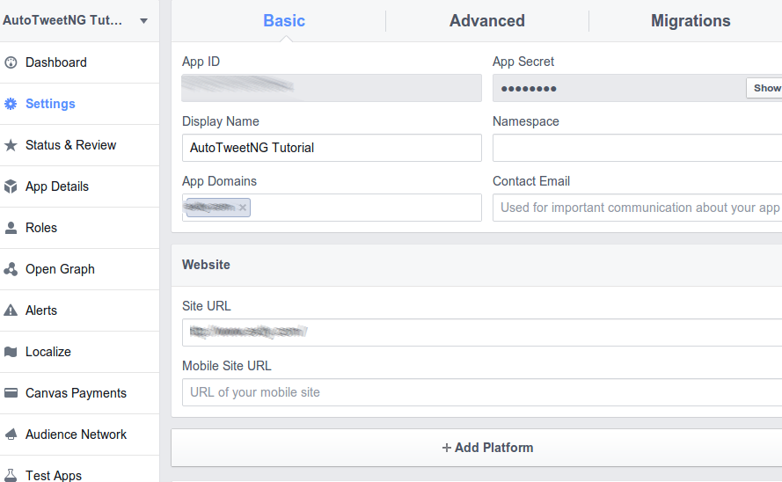
Add channel / Facebook
Create a Facebook App
Now, you have your own:
App ID
App Secret
Don’t forget to fill:
App Domain,
Contact Email
Site URL
yourdomain.com
http://www.yourdomain.com

Slide 14
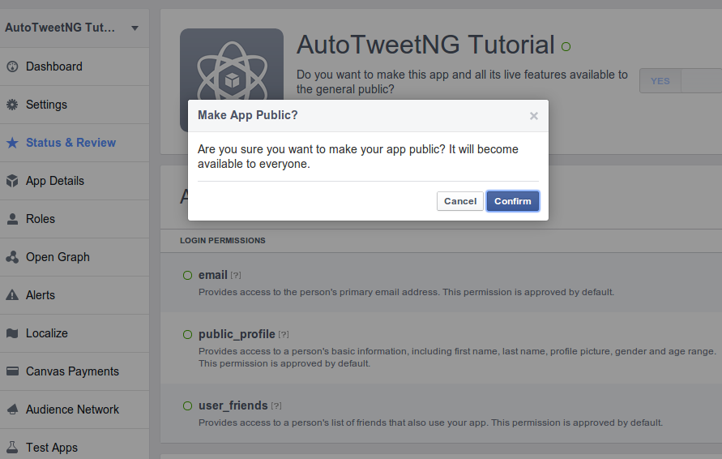
Add channel / Facebook
Create a Facebook App
Now, you have your own:
App ID
App Secret
Don’t forget to :
Make it public

Slide 15
Add channel / Facebook
Create a Facebook App
Now, you have your own:
App ID
App Secret
TIP
Make sure “Stream post URL security” is OffThis setting allows Url Shorteners usage, or a different domains.

Slide 16
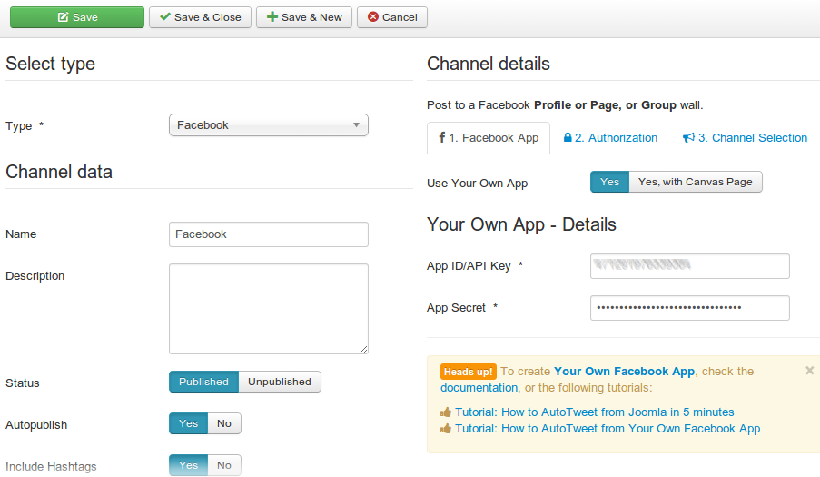
Add channel / Facebook
Back to the channel configuration
Fill the form: App Id, and App Secret
Continue with steps: 2. Authorization and 3. Channel Selection

Slide 17
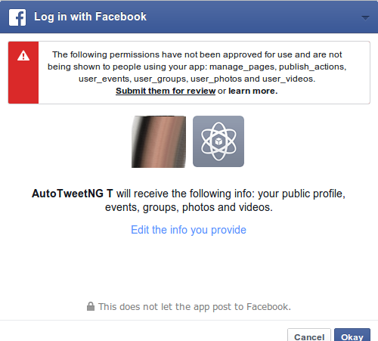
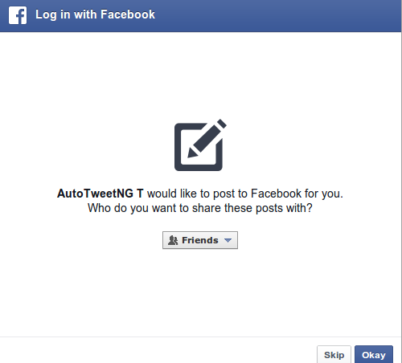
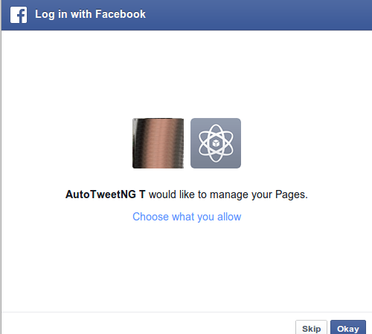
Add channel / Facebook
Step 2: Authorize the App in the Facebook Account

Slide 18
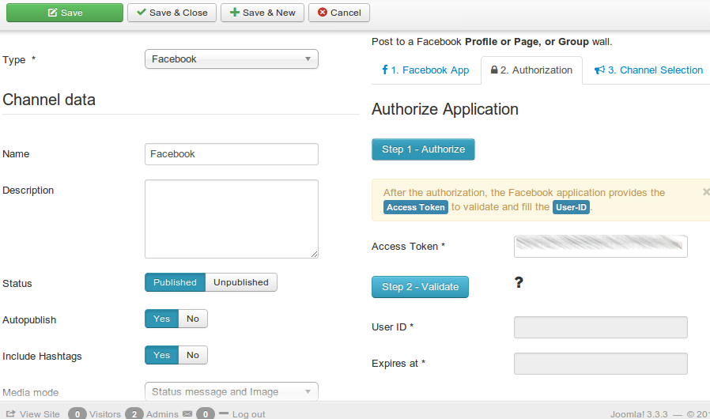
Add channel / Facebook
After the authorization, the Facebook application provides the Access Token to validate and fill the User-ID.

Slide 19
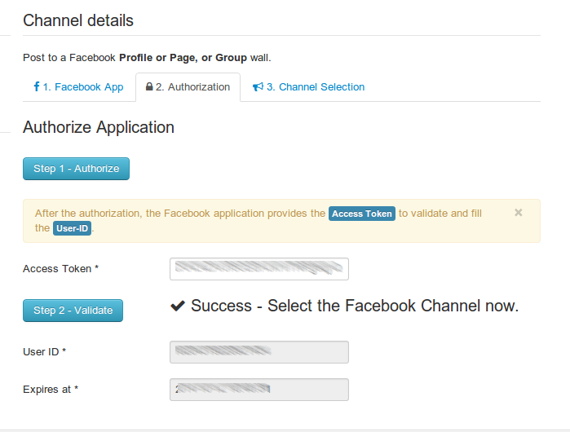
Add channel / Facebook
Validate the Access token and the User ID will be filled

Slide 20
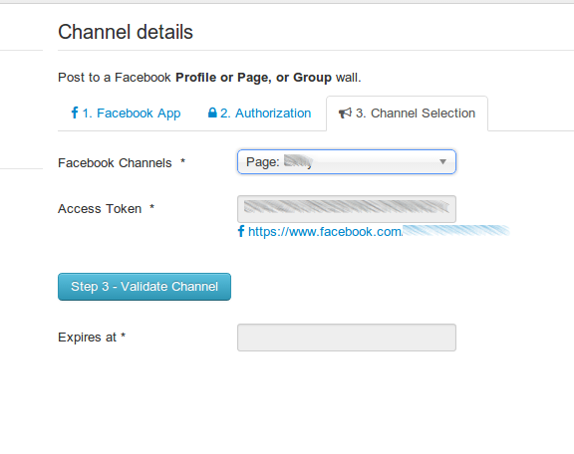
Add channel / Facebook
Select the specific Facebook channel (Page, group, or profile)
Validate Channel and Save

Slide 21
Add channel / Facebook
AutoTweetNG is ready to publish!
A new authorization Access token has been granted.
A new Facebook Channel has been created.
By default, all new articles are going to be published to Facebook.

Slide 22
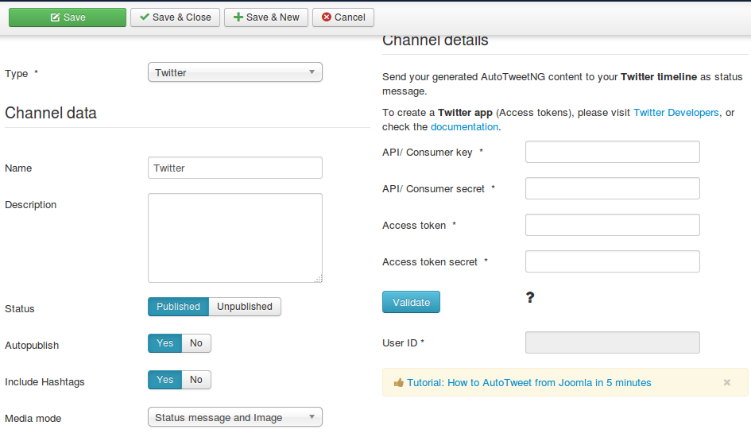
Add channel / Twitter
Assign channel type and data
Create your Twitter Authorization App
Assign Channel details

Slide 23
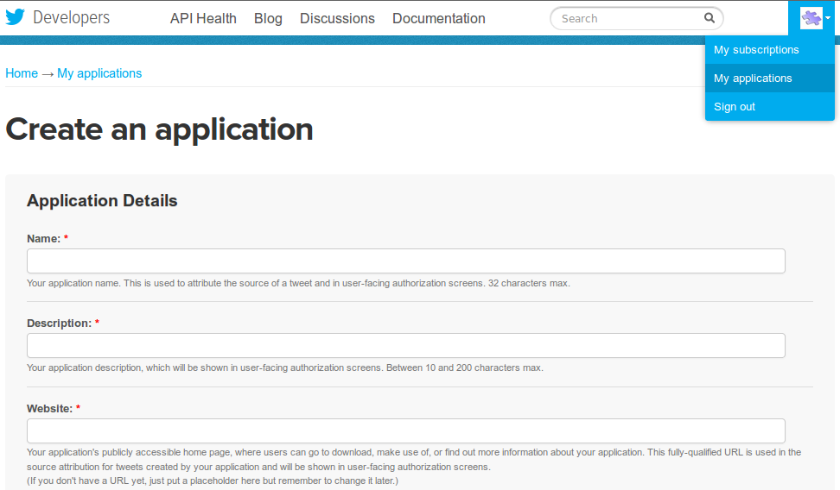
Add channel / Twitter
Login at https://dev.twitter.com/ with your Twitter username and password
Go to My applications and create an application to start using the Twitter API

Slide 24
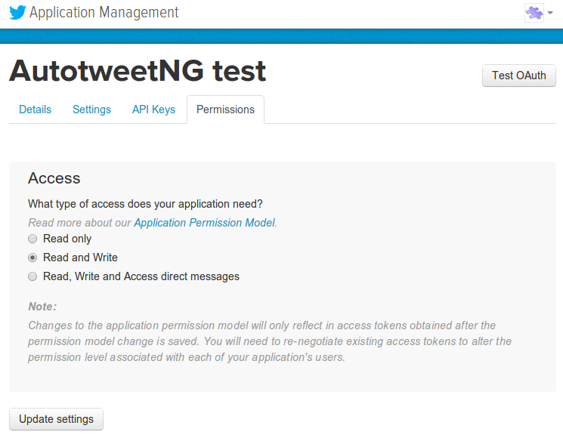
Add channel / Twitter
Go to Permissions tab, Access must be Read and Write

Slide 25
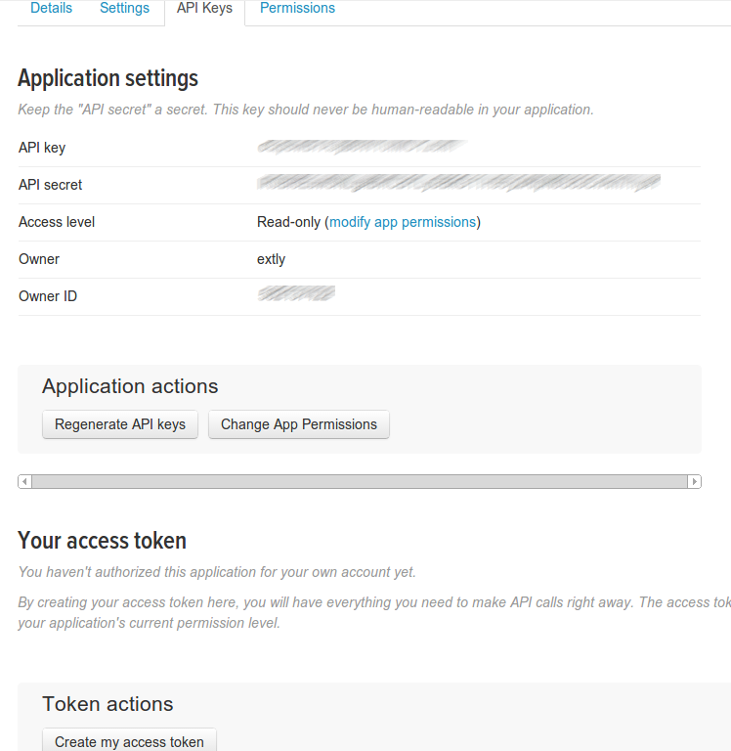
Add channel / Twitter
You already have your Keys, check API Keys Tab, OAuth settings.
Press "Create my access token"

Slide 26
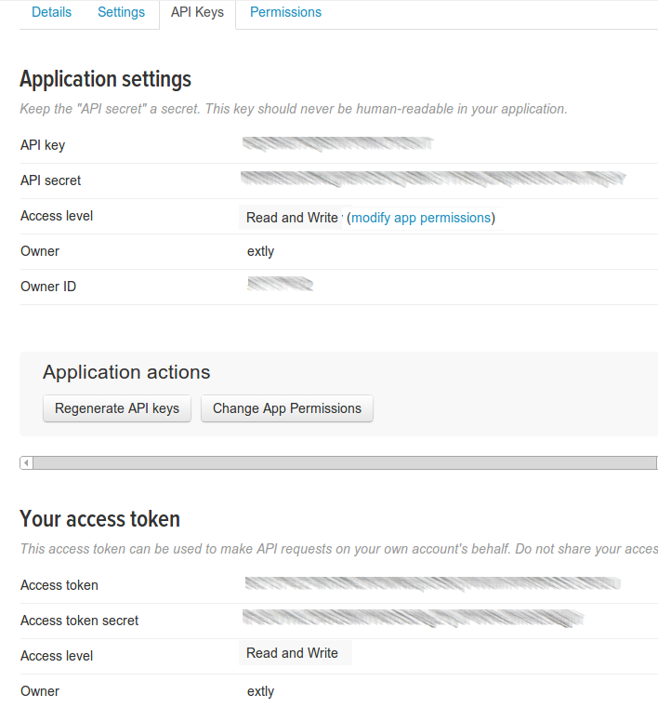
Add channel / Twitter
Copy and paste your keys in the channel data

Slide 27
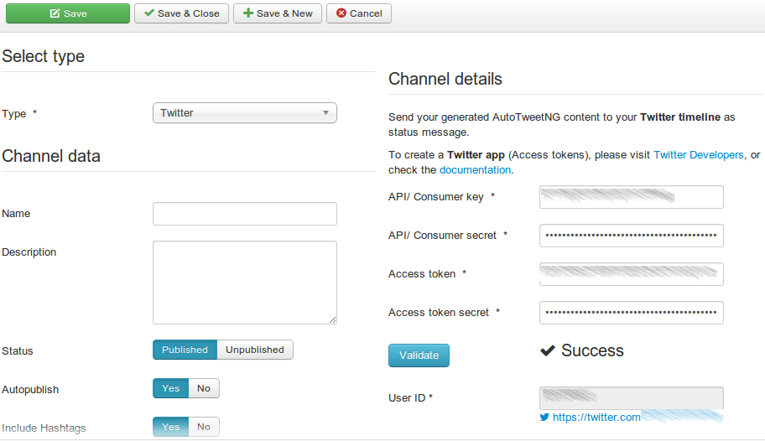
Add channel / Twitter
Copy and paste your keys and token in channel details
Click on Validate and the User ID will be filled

Slide 28
Add channel / Twitter
AutoTweetNG is ready to publish!
A new Twitter App, keys and tokens have been created.
A new Twitter Channel has been created.
By default, all new articles are going to be published to Twitter.

Slide 29
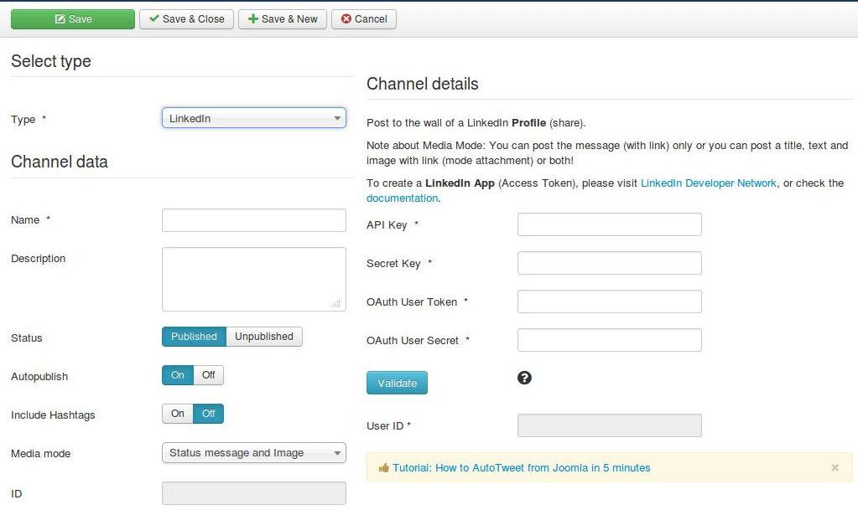
Add channel / LinkedIn
Every Profile, or Group is a different channel.
A channel access requires the account authorization.

Slide 30
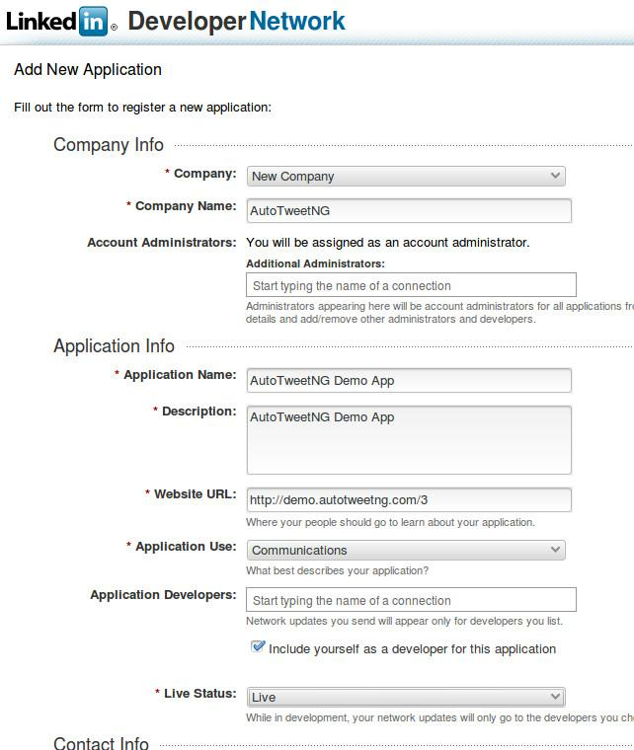
Add channel / LinkedIn
Login at https://developer.linkedin.com/ with your LinkedIn username and password
Go to API Keys and click on Add New Application

Slide 31
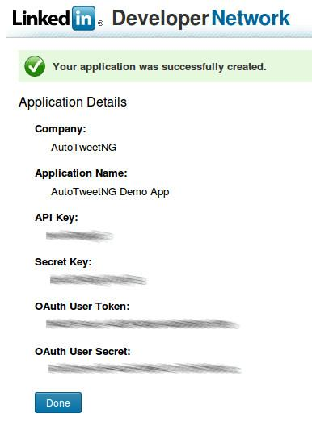
Add channel / LinkedIn
You have your Keys & Tokens
Remember to enable these permissions

Slide 32
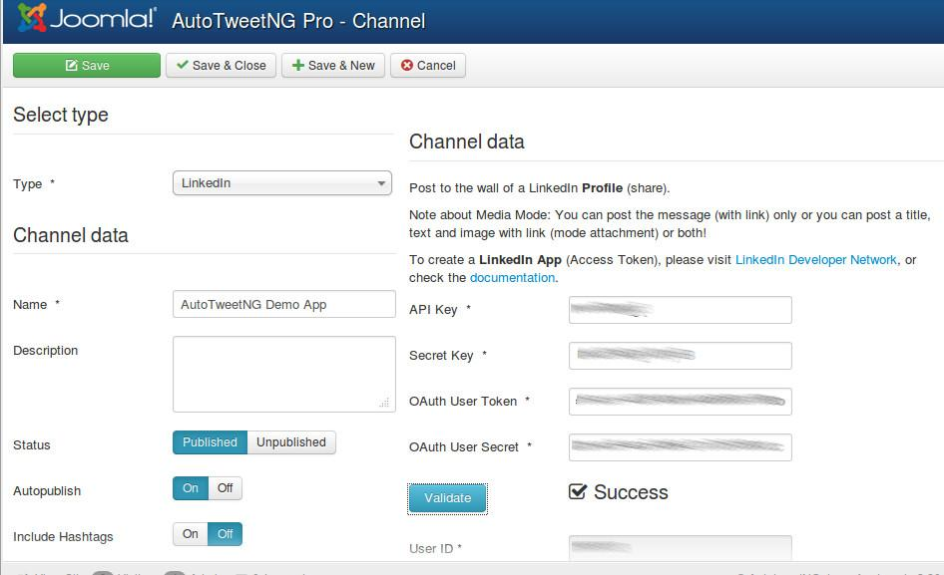
Add channel / LinkedIn
Copy and paste your keys in the channel data
Click on Validate and the User ID will be filled

Slide 33
Add channel / LinkedIn
AutoTweetNG is ready to publish!
A new LinkedIn App, Keys and tokens have been created.
A new LinkedIn Channel has been created.
By default, all new articles are going to be published to LinkedIn.

Slide 34
Create a test article
1. Create an article 4. Check the Posts list
2. Check the Requests list 5. Check Facebook,
3. Wait 3 minutes, visit the frontpage Twitter, or LinkedIn
Plugins
Requests
Posts
Feeds
Rules

Slide 35
Advanced: Posting on page load vs cronjob task
There's always a delayed publication, caused by Social Channel API processing times. By default, only when front pages are visited Requests and Posts are processed by the Automator plugin (every 2-3 minutes). The processing modes are:
1. Manual, you can push a request of the queue
2. Automator Plugin, on front-site page load requests are processed
3. Cronjob task, for heavy loads, on periodic command line calls requests are processed
4. Web Cronjob task, to schedule a periodic page load to process requests
The Automator Plugin is the most common solution.
To configure the Cronjob task, you must run the command line:
Or, to run the Web cron job task (AutoTweetNG / Joomcial v7.3.1, or superior):
Enable and configure cronjob mode in AutoTweetNG backend parameters. Options / Cronjob mode / Cron mode = On.
Reference: User Manual: Automating your social publishing
php -f /[PATH_TO_JOOMLA_ROOT]/cli/autotweetstartcronjob.php
wget -O /dev/null "http://www.yoursite.com/index.php?option=com_autotweet&view=cron&task=run&key=Secret"

Slide 36
One last word
We love your feedback, it's our way to improve.
This presentation was created with your help.
Please post a rating and a review at the #JED
It really helps ;-)
Support: http://support.extly.com Community Forum Support: http://www.extly.com/forum/index.html
Twitter @extly
Facebook facebook.com/extly

